Slide 1

Chapter 20
Symmetric Encryption and Message Confidentiality
Notes:
This section begins with a look at a general model for the symmetric encryption process; this will enable us to understand the context within which the
algorithms are used. Then we look at three important block encryption algorithms: DES, triple DES, and AES. Next, the chapter introduces symmetric stream encryption. We then examine the application of these algorithms to achieve confidentiality.

Slide 2


Symmetric Encryption
Also referred to as:
Conventional encryption
Secret-key or single-key encryption
Only alternative before public-key encryption in 1970’s
Still most widely used alternative
Has five ingredients:
Plaintext
Encryption algorithm
Secret key
Ciphertext
Decryption algorithm
Notes:
Symmetric encryption, also referred to as conventional encryption, secret-key, or single-key encryption, was the only type of encryption in use prior to the
development of public-key encryption in the late 1970s. It remains by far the most widely used of the two types of encryption.
At this point the reader should review Section 2. Recall that a symmetric encryption scheme has five ingredients ( Figure 2.1 ):
• Plaintext : This is the original message or data that is fed into the algorithm as input.
• Encryption algorithm: The encryption algorithm performs various substitutions and transformations on the plaintext.
• Secret key: The secret key is also input to the algorithm. The exact substitutions and transformations performed by the algorithm depend on the key.
• Ciphertext : This is the scrambled message produced as output. It depends on the plaintext and the secret key. For a given message, two different keys will produce two different ciphertexts.
• Decryption algorithm: This is essentially the encryption algorithm run in reverse. It takes the ciphertext and the same secret key and produces the original plaintext.

Slide 3
Cryptography
classified along three independent dimensions:
The type of operations used for transforming plaintext to ciphertext
Substitution – each element in the plaintext is mapped into another element
Transposition – elements in plaintext are rearranged
The number of keys used
Sender and receiver use same key – symmetric
Sender and receiver each use a different key - asymmetric
The way in which the plaintext is processed
Block cipher – processes input one block of elements at a time
Stream cipher – processes the input elements continuously
Notes:
Cryptographic systems are generically classified along three independent dimensions:
The type of operations used for transforming plaintext to ciphertext.
All encryption algorithms are based on two general principles: substitution, in which each element in the plaintext (bit, letter, group of bits or letters) is mapped into another element, and transposition, in which elements in the plaintext are rearranged. The fundamental requirement is that no information be lost (i.e., that all operations be reversible). Most systems, referred to as product systems, involve multiple stages of substitutions and transpositions.
2. The number of keys used.
If both sender and receiver use the same key, the system is referred to as symmetric, single-key, secret-key, or conventional encryption. If the sender and receiver each use a different key, the system is
referred to as asymmetric, two-key, or public-key encryption.
3. The way in which the plaintext is processed.
A block cipher processes the input one block of elements at a time, producing an output block for each input block. A stream cipher processes the input elements continuously, producing
output one element at a time, as it goes along.

Slide 4

Substitution Ciphers
Replaces one symbol with another. If the symbols in the plaintext are alphabetic characters, we replace one character with another.
A substitution cipher replaces one symbol with another.
i
The simplest substitution cipher is a shift cipher (additive cipher)
Notes:
The substitution refers to replacing one symbol with another. If the symbols in the plaintext are alphabetic characters, we replace one character with another. The simplest substitution cipher is a shift cipher, also called an additive cipher, where each character is replaced in the message by the character + a position shift in the alphabet.

Slide 5
Substitution Cipher
Example Shift Cipher
Use the additive cipher with key = 15 to encrypt the message “hello”.
Solution
We apply the encryption algorithm to the plaintext, character by character:
The ciphertext is therefore “wtaad”.
Notes:
This shows an example of a simple shift cipher where each character is shifted 15 places in the alphabet and if the shift goes past ‘z’ then it starts from ‘a’ again, ex. l and o.

Slide 6
Transposition Ciphers
A transposition cipher does not substitute one symbol for another, instead it changes the location of the symbols.
A symbol in the 1st position of the plaintext may appear in the 10th position of the ciphertext, while a symbol in the 8th position in the plaintext may appear in the 1st position of the ciphertext.
In other words, a transposition cipher reorders (transposes) the symbols.
i
A transposition cipher reorders symbols.
Notes:
A simple Transposition cipher moves symbols/characters around in a message.

Slide 7
Transposition Cipher
Alice needs to send the message “Enemy attacks tonight” to Bob.
Alice and Bob have agreed to divide the text into groups of five characters and then permute the characters in each group.
The following shows the grouping after adding a bogus character (z) at the end to make the last group the same size as the others.
The key used for encryption and decryption is a permutation key, which shows how the character are permuted.
For this message, assume that Alice and Bob used the following key:
Notes:
Shows how the message “enemy attacks tonight” is transposed according to the permutation matrix/key. The message is first grouped into 5 character blocks and the last block is padded with ‘z’ if necessary.

Slide 8
Transposition Cipher
The 3rd character in the plaintext block becomes the 1st character in the ciphertext block. Etc….
The permutation yields:
Alice sends the ciphertext “eemyntaacttkonshitzg” to Bob.
Bob divides the ciphertext into five-character groups and, using the key in the reverse order, finds the plaintext.
Notes:
Shows the Transposition Cipher in operation.

Slide 9
Symmetric (Secret Key) Encryption
Since these traditional ciphers are no longer secure due to PC processing power, modern symmetric-key ciphers have been developed over the last few decades.
Modern ciphers normally use a combination of substitution, transposition and some other complex transformations to create a ciphertext from a plaintext.
Modern ciphers are bit-oriented (instead of character-oriented). The plaintext, ciphertext and the key are strings of bits.
Some examples of modern symmetric-key ciphers are DES, AES and IDEA.
Notes:
Modern ciphers use the aforementioned techniques but at a bit level. We will see the DES and AES ciphers later.

Slide 10
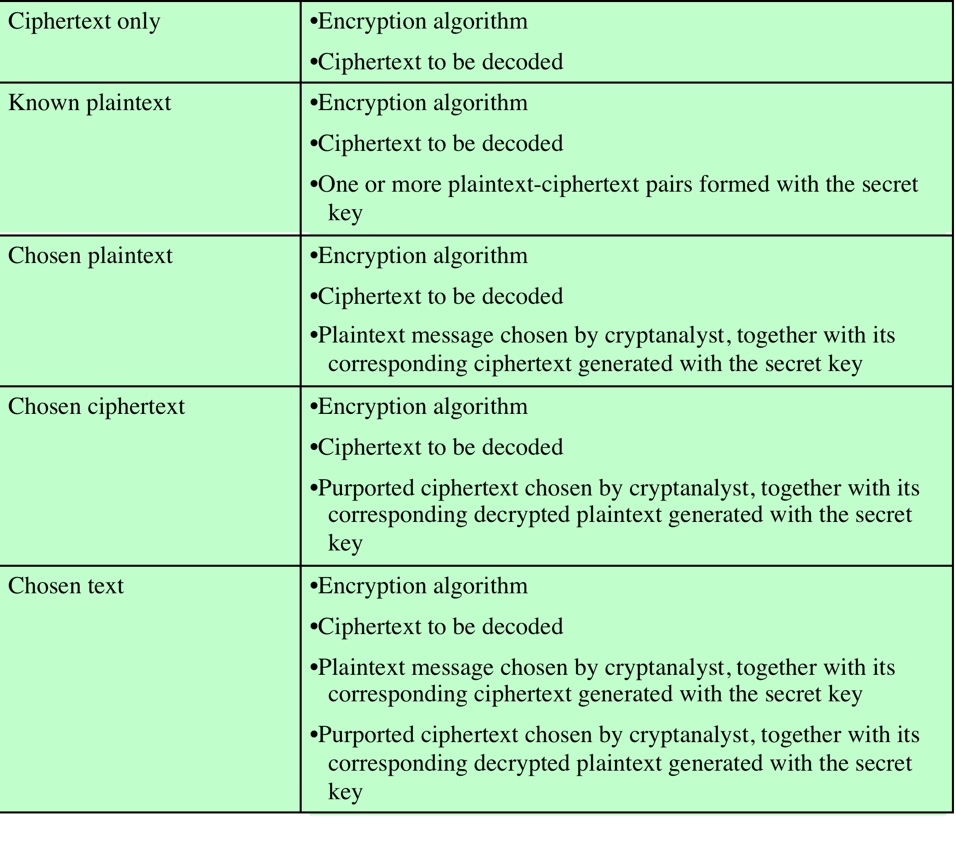
Cryptanalysis
type of attack
known to cryptanalyst
Notes:
The process of attempting to discover the plaintext or key is known as cryptanalysis .
The strategy used by the cryptanalyst depends on the nature of the encryption scheme and the information available to the cryptanalyst.
The Table summarizes the various types of cryptanalytic attacks, based on the amount of information known to the cryptanalyst. The most difficult problem is presented when all that is available is the ciphertext only . In some cases, not even the encryption algorithm is known, but in general we can assume that the opponent does know the algorithm used for encryption. One possible attack under these circumstances is the brute-force approach of trying all possible keys. If the key space is very large, this becomes impractical. Thus, the opponent must rely on an analysis of the ciphertext itself, generally applying various statistical tests to it. To use this approach, the opponent must have some general idea of the type of plaintext that is concealed, such as English or French text, an EXE file, a Java source listing, an accounting file, and so on.
The ciphertext-only attack is the easiest to defend against because the opponent has the least amount of information to work with. In many cases, however, the analyst has more information. The analyst may be able to capture one or more plaintext messages as well as their encryptions. Or the analyst may know that certain plaintext patterns will appear in a message. For example, a file that is encoded in the Postscript format always begins with the same pattern, or there may be a standardized header or banner to an electronic funds transfer message, and so on. All these are examples of known plaintext. With this knowledge, the analyst may be able to deduce the key on the basis of the way in which the known plaintext is transformed.
Closely related to the known-plaintext attack is what might be referred to as a probable-word attack. If the opponent is working with the encryption of some general prose message, he or she may have little knowledge of what is in the message. However, if the opponent is after some very specific information, then parts of the message may be known. For example, if an entire accounting file is being transmitted, the opponent may know the placement of certain key words in the header of the file. As another example, the source code for a program developed by a corporation might include a copyright statement in some standardized position. If the analyst is able somehow to get the source system to insert into the system a message chosen by the analyst, then a chosen-plaintext attack is possible. In general, if the analyst is able to choose the messages to encrypt, the analyst may deliberately pick patterns that can be expected to reveal the structure of the key.
The Table lists two other types of attack: chosen ciphertext and chosen text. These are less commonly employed as cryptanalytic techniques but are nevertheless possible avenues of attack. Only relatively weak algorithms fail to withstand a ciphertext-only attack. Generally, an encryption algorithm is designed to withstand a known-plaintext attack.

Slide 11
Computationally Secure Encryption Schemes
Encryption is computationally secure if:
Cost of breaking cipher exceeds value of information
Time required to break cipher exceeds the useful lifetime of the information
Usually very difficult to estimate the amount of effort required to break
Can estimate time/cost of a brute-force attack
Notes:
An encryption scheme is computationally secure if the ciphertext generated by the scheme meets one or both of the following criteria:
• The cost of breaking the cipher exceeds the value of the encrypted information.
• The time required to break the cipher exceeds the useful lifetime of the information.
Unfortunately, it is very difficult to estimate the amount of effort required to cryptanalyze ciphertext successfully. However, assuming there are no inherent
mathematical weaknesses in the algorithm, then a brute-force approach is indicated, and here we can make some reasonable estimates about costs and time.
A brute-force approach involves trying every possible key until an intelligible translation of the ciphertext into plaintext is obtained. On average, half of all
possible keys must be tried to achieve success.

Slide 12
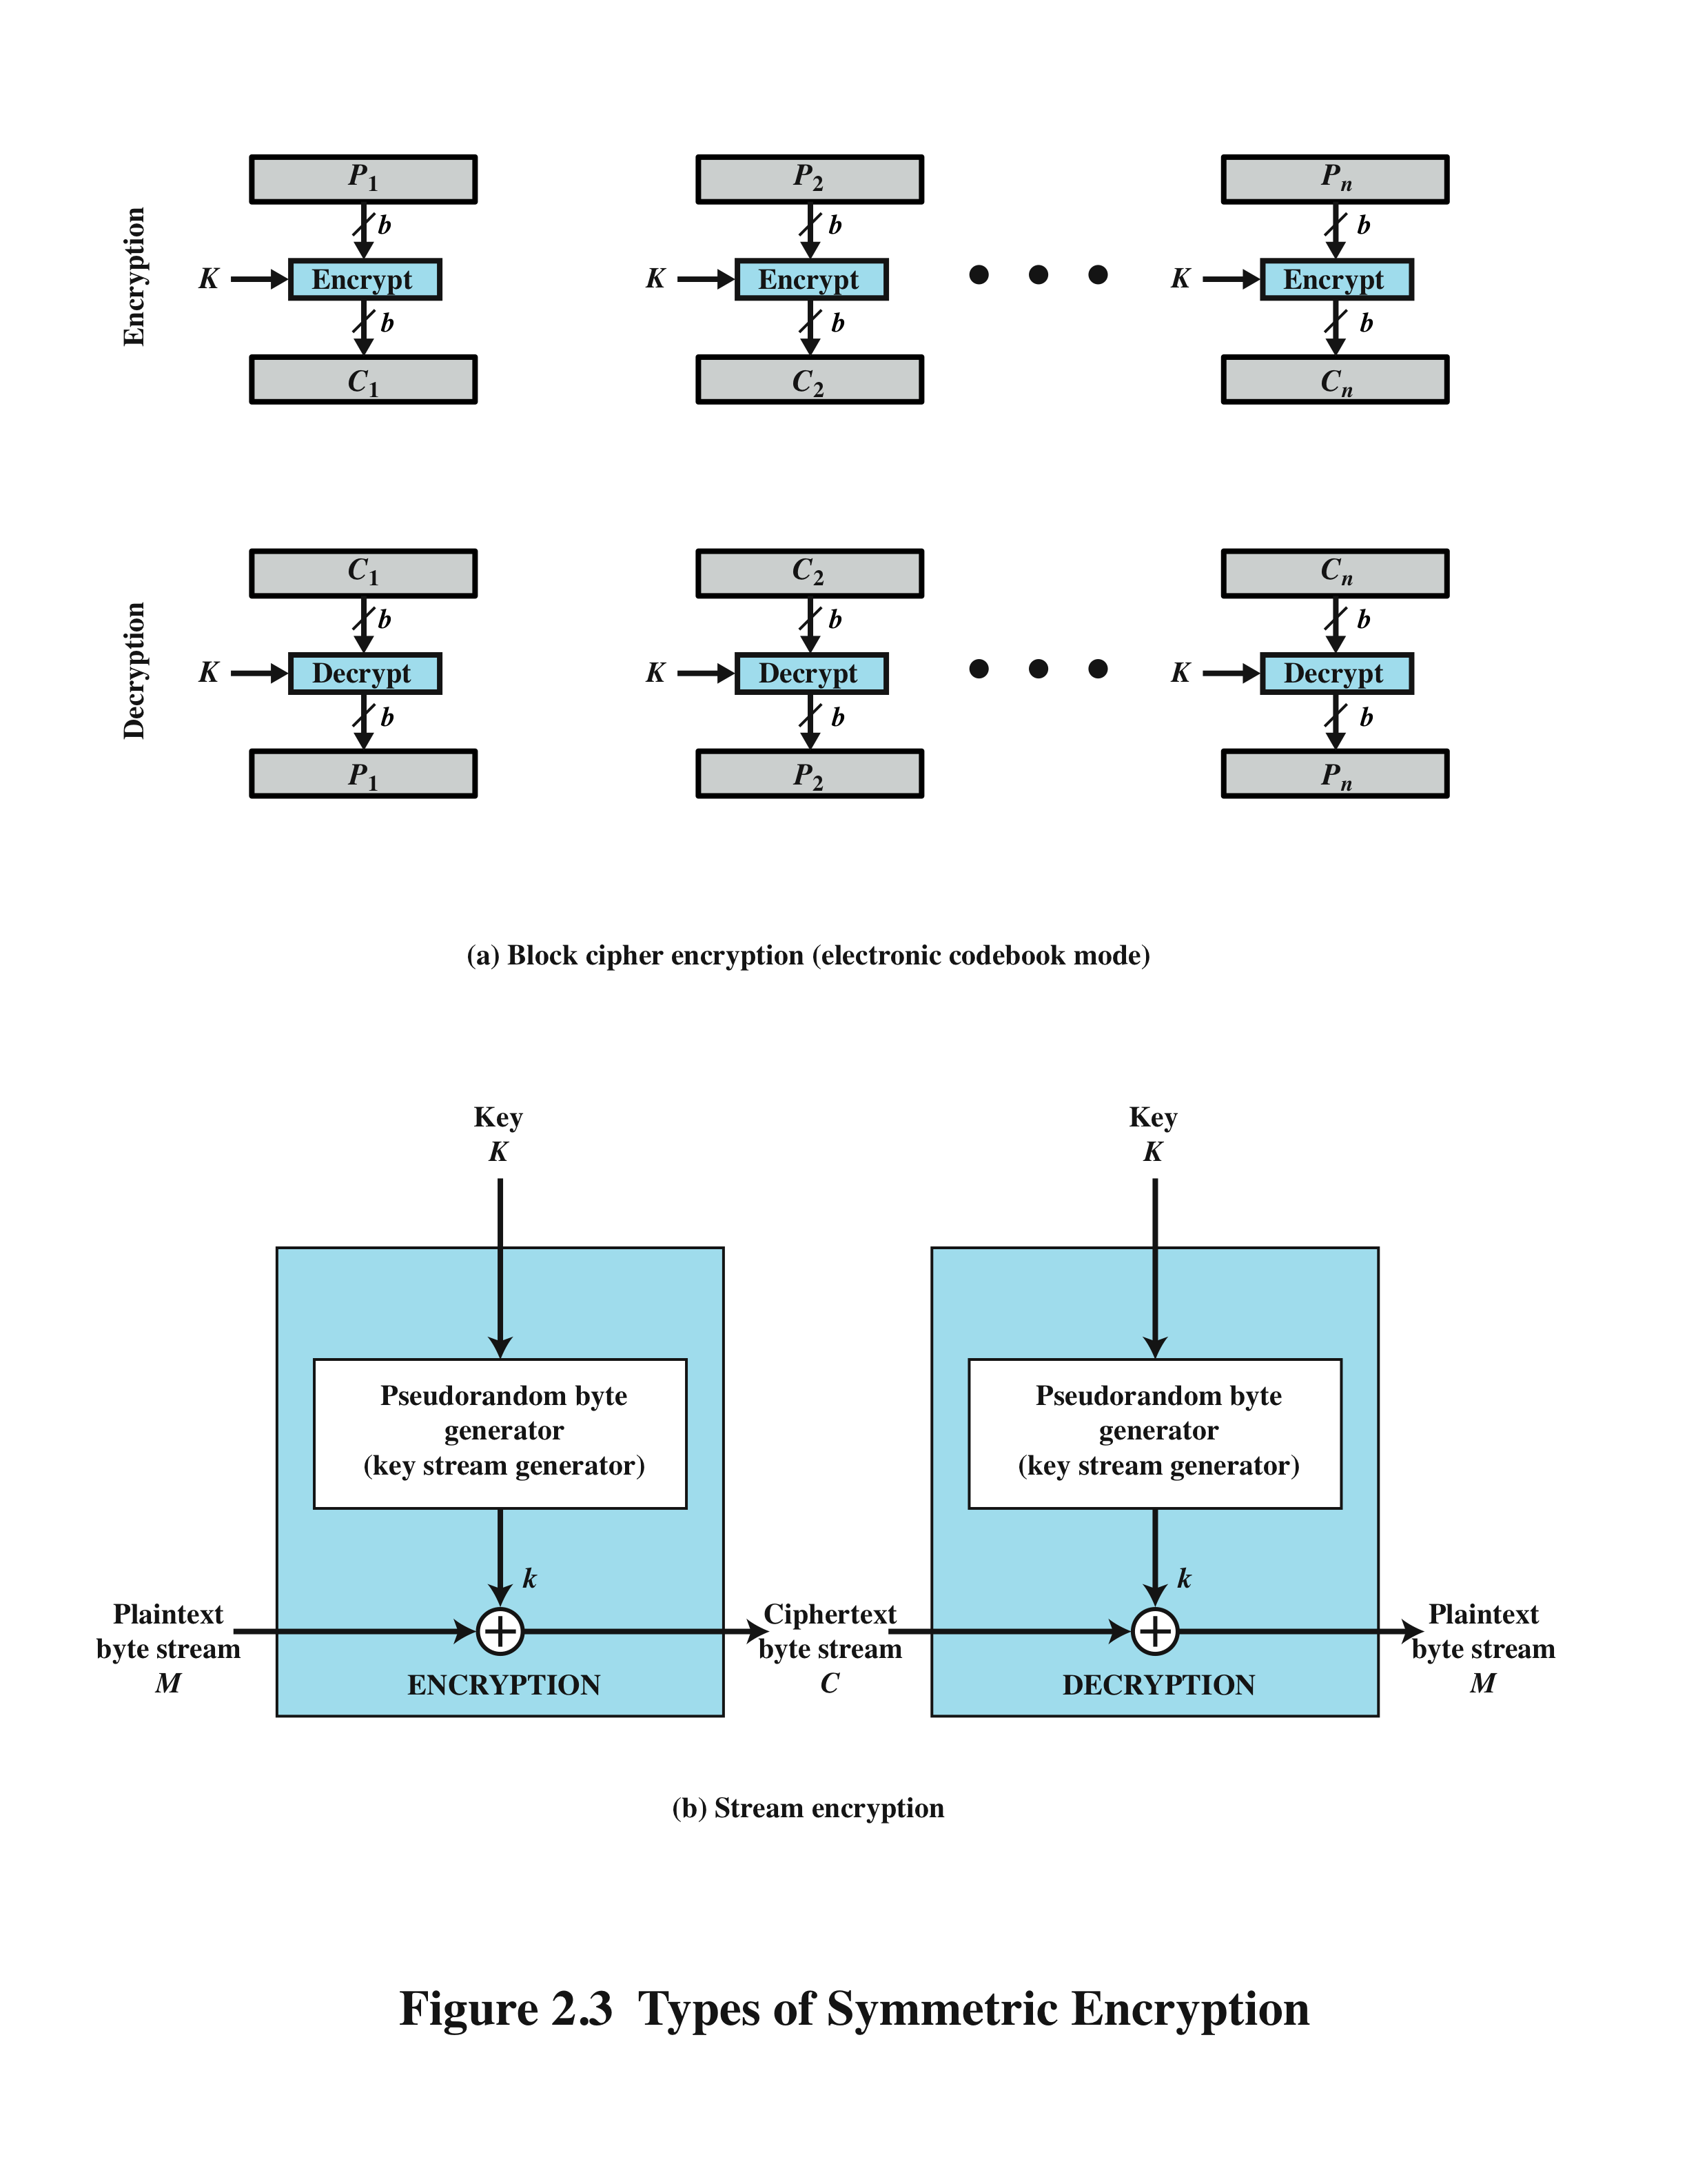
Block Cipher Encryption Stream Encryption
Notes:
Figure (a) shows the ECB mode of operation.
A plaintext of length nb is divided into n b-bit blocks (P1, P2,…..,Pn). Each block is encrypted using the same algorithm and the same encryption key, to produce a sequence of n b-bit blocks of ciphertext (C1, C2,…..,Cn).
Figure (b) is a representative diagram of stream cipher structure. In this structure a key is input to a pseudorandom bit generator that produces a stream of 8-bit numbers that are apparently random. A pseudorandom stream is one that is unpredictable without knowledge of the input key and which has an apparently random character. The output of the generator, called a keystream, is combined one byte at a time with the plaintext stream using the bitwise exclusive-OR (XOR) operation.

Slide 13
Block & Stream Ciphers
Block Cipher
Processes the input one block of elements at a time
Produces an output block for each input block
Can reuse keys
More common
Stream Cipher
Processes the input elements continuously
Produces output one element at a time
Primary advantage is that they are almost always faster and use far less code
Encrypts plaintext one byte at a time
Pseudorandom stream is one that is unpredictable without knowledge of the input key
Stream ciphers are vulnerable to attack if the same key is used twice or more.
Notes:
A block cipher processes the input one block of elements at a time, producing an output block for each input block. A stream cipher processes the input elements continuously, producing output one element at a time, as it goes along. Although block ciphers are far more common, there are certain applications in which a stream cipher is more appropriate. Examples are given subsequently in this book.
A typical stream cipher encrypts plaintext one byte at a time, although a stream cipher may be designed to operate on one bit at a time or on units larger than a byte at a time. Figure 2.3b is a representative diagram of stream cipher structure.
With a properly designed pseudorandom number generator, a stream cipher can be as secure as block cipher of comparable key length. The primary advantage of a stream cipher is that stream ciphers are almost always faster and use far less code than do block ciphers.
The advantage of a block cipher is that you can reuse keys – reusing keys with stream ciphers makes them vulnerable to attack due to the use of XOR, ie. The same key (k) will generate the same pseudo random number PRG(k) to be XORed with the plaintext byte (m), therefore the following applies:
C1 = m1 xor PRG(k) C2 = m2 xor PRG(k) --> C1 xor C2 = m1 xor m2 This process can allow plaintext to be recovered if k is used multiple time.
For applications that require encryption/decryption of a stream of data, such as over a data communications channel or a browser/Web link, a stream cipher might be the better alternative. For applications that deal with blocks of data, such as file transfer, e-mail, and database, block ciphers may be more appropriate. However, either type of cipher can be used in virtually any application.

Slide 14
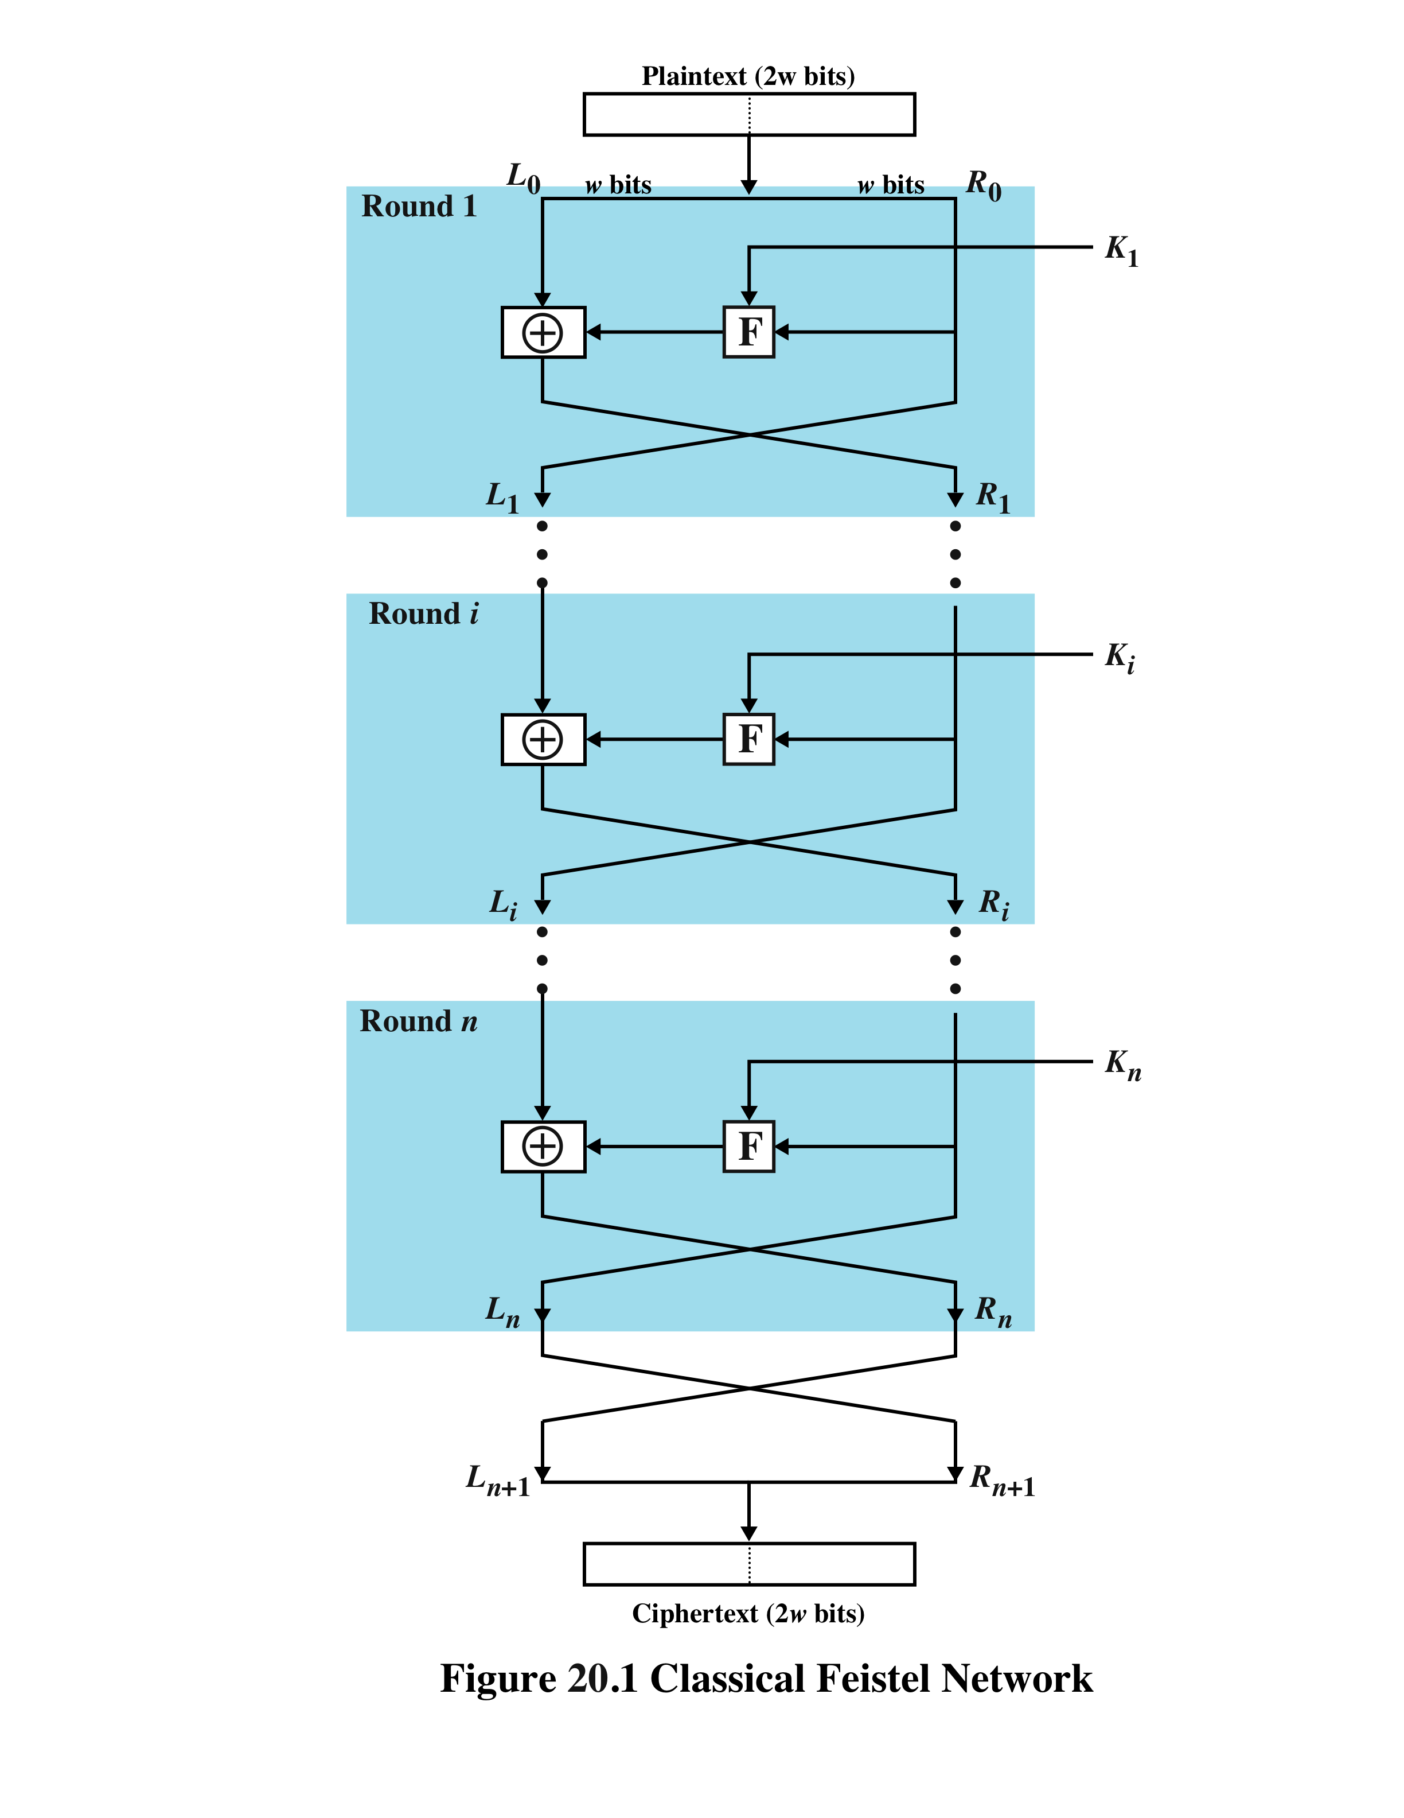
Feistel Cipher Structure
Notes:
Many symmetric block encryption algorithms, including DES, have a structure first described by Horst Feistel of IBM in 1973 [FEIS73] and shown in Figure 20.1 . The inputs to the encryption algorithm are a plaintext block of length 2w bits and a key K . The plaintext block is divided into two halves, L₀ and R₀.
The two halves of the data pass through n rounds of processing and then combine to produce the ciphertext block. Each round i has as inputs L _{i-1} and R _{i-1} , derived from the previous round, as well as a subkey K_{i} , derived from the overall K . In general, the subkeys K _{i} are different from K and from each other and are generated from the key by a subkey generation algorithm.
All rounds have the same structure. A substitution is performed on the left half of the data. This is done by applying a round function F to the right half of the data and then taking the exclusive-OR (XOR) of the output of that function and the left half of the data. The round function has the same general structure for each round but is parameterized by the round subkey K_{i}. Following this substitution, a permutation is performed that consists of the interchange of the two halves of the data.

Slide 15
Block Cipher Structure
Symmetric block cipher consists of:
A sequence of rounds
With substitutions and permutations controlled by the key
Parameters and design features:
block size
key size
number of rounds
subkey generation algorithm
round function
fast software encryption/decryption
ease of analysis
Notes:
The Feistel structure is a particular example of the more general structure used by all symmetric block ciphers. In general, a symmetric block cipher consists of a sequence of rounds, with each round performing substitutions and permutations conditioned by a secret key value. The exact realization of a symmetric block cipher depends on the choice of the following parameters and design features:
• Block size: Larger block sizes mean greater security (all other things being equal) but reduced encryption/decryption speed. A block size of 128 bits is a reasonable tradeoff and is nearly universal among recent block cipher designs.
• Key size: Larger key size means greater security but may decrease encryption/decryption speed. The most common key length in modern algorithms is 128 bits.
• Number of rounds: The essence of a symmetric block cipher is that a single round offers inadequate security but that multiple rounds offer increasing security. A typical size is 16 rounds.
• Subkey generation algorithm : Greater complexity in this algorithm should lead to greater difficulty of cryptanalysis.
• Round function: Again, greater complexity generally means greater resistance to cryptanalysis.
There are two other considerations in the design of a symmetric block cipher:
• Fast software encryption/decryption: In many cases, encryption is embedded in applications or utility functions in such a way as to preclude a hardware implementation. Accordingly, the speed of execution of the algorithm becomes a concern.
• Ease of analysis: Although we would like to make our algorithm as difficult as possible to cryptanalyze, there is great benefit in making the algorithm easy to analyze. That is, if the algorithm can be concisely and clearly explained, it is easier to analyze that algorithm for cryptanalytic vulnerabilities and therefore develop a higher level of assurance as to its strength. DES, for example, does not have an easily analyzed functionality.
Decryption with a symmetric block cipher is essentially the same as the encryption process. The rule is as follows: Use the ciphertext as input to the algorithm, but use the subkeys K _{i} in reverse order. That is, use K _{n} in the first round, K _{n-1} in the second round, and so on until K ₁ is used in the last round. This is a nice feature because it means we need not implement two different algorithms, one for encryption and one for decryption.

Slide 16
Most widely used encryption scheme
Adopted in 1977 by National Bureau of Standards
Now NIST
FIPS PUB 46
Algorithm is referred to as the Data Encryption Algorithm (DEA)
Minor variation of the Feistel network
Data Encryption Standard (DES)
Notes:
The most widely used encryption scheme is based on the Data Encryption Standard (DES) adopted in 1977 by the National Bureau of Standards, now the National Institute of Standards and Technology (NIST), as Federal Information Processing Standard 46 (FIPS PUB 46). The algorithm itself is referred to as the Data Encryption Algorithm (DEA).
The DES algorithm can be described as follows. The plaintext is 64 bits in length and the key is 56 bits in length; longer plaintext amounts are processed in 64-bit blocks. The DES structure is a minor variation of the Feistel network shown in Figure 20.1 (Permutations and 16th round has no L/R swap). There are 16 rounds of processing. From the original 56-bit key, 16 subkeys are generated, one of which is used for each round.
The process of decryption with DES is essentially the same as the encryption process. The rule is as follows: Use the ciphertext as input to the DES algorithm, but use the subkeys K _{i} in reverse order. That is, use K₁₆ on the first iteration, K₁₅ on the second iteration, and so on until K₁ is used on the sixteenth and last iteration.
Basics:
DES uses the two basic techniques of cryptography - confusion and diffusion. At the simplest level, diffusion is achieved through numerous permutations and confusions is achieved through the XOR operation.

Slide 17
DES
64 bit plaintext block
IP
L₀
R₀
32
32
K₁ (derived from 56 bit key)
f
L₁=R₀
R₁=L₀ + f(R₀,K₁)
repeat 16 times…
K₁₆ (derived from 56 bit key)
f
R₁₆=L₁₅ + f(R₁₅,K₁₆)
L₁₆=R₁₅
IP⁻¹
64 bit ciphertext block
Notes:
The basic process in enciphering a 64-bit data block and a 56-bit key using the DES consists of:
An initial permutation (IP)
16 rounds of a complex key dependent calculation f
A final permutation, being the inverse of IP
Process:
The 64-bit block being enciphered is broken into two halves, Left (L) and Right (R).
The right half goes through one DES round with the subkey, i.e. f(R, K). The unaltered right half also becomes the new left half for the next round.
The old left half becomes the new right half, after and XOR operation with f(R, K) and will go through to the next round.
This goes on for 16 rounds, but after the last round the left and right halves are not swapped, so that the result of the 16th round becomes the final right half, and the result of the 15th round (which became the left half of the 16th round) is the final left half.

Slide 18
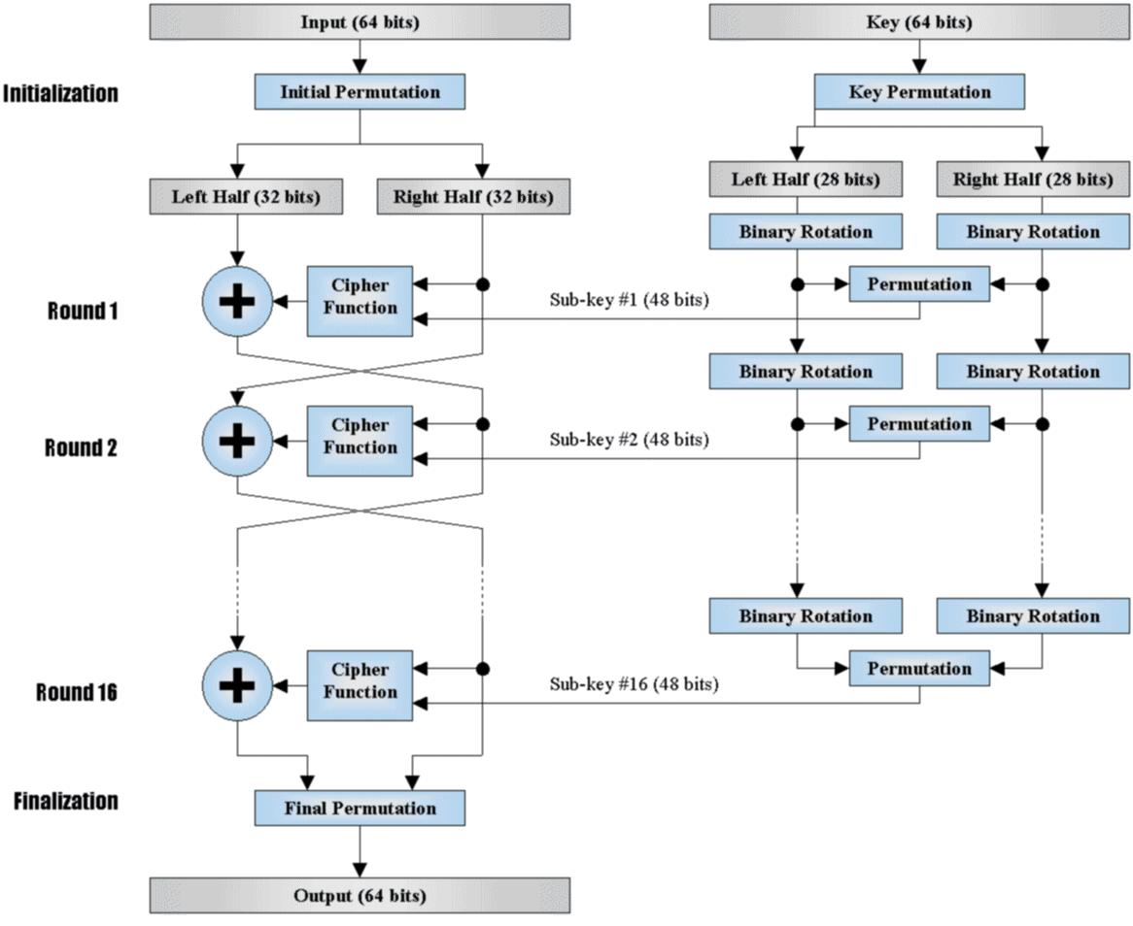
DES
64 bit plaintext block
IP
L₀
R₀
32
32
K₁ (derived from 56 bit key)
f
L₁=R₀
R₁=L₀ + f(R₀,K₁)
repeat 16 times…
K₁₆ (derived from 56 bit key)
f
R₁₆=L₁₅ + f(R₁₅,K₁₆)
L₁₆=R₁₅
IP⁻¹
64 bit ciphertext block
Notes:
Here we see how the 16 subkeys are generated from the 64bit key. A process of permutation and halving is initially used. Each subkey (all 16 of them) is then generated from a rotation (specified for each subkey) followed by a permutation (same for each key). This process is explained in the following slides.

Slide 19
IP (Initial Permutation)
56
48
40
32
24
16
8
56
48
40
32
24
16
8
Notes:
The initial permutation of the 64bit plaintext block. Input on top, output on bottom.

Slide 20
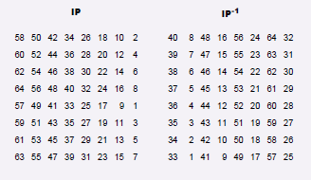
IP (Initial Permutation)
56
48
40
32
24
16
8
56
48
40
32
24
16
8
Notes:
Permutation in table form. This show that bit 58 (input) is moved to bit 1 (output) and so on. (note bits are numbered from 1)

Slide 21
48 bit subkey
Generator
K₄₈ = g(i,K₅₆)
(The key for
each round is
deterministically
found from the
input 56 bit key).
L₀
R₀
32
32
Expansion Permutation
48
48
48
S-Box Substitution
32
This can be described functionally as
L(i) = R(i-1)
R(i) = L(i-1) ⊕ P(S( E(R(i-1)) ⊕ K(i) ))
This forms one round in an S-P network
P-Box Permutation
32
32
32
L₁
R₁
Notes:
The f( ) function in DES is a cumulation of:
Expansion permutation (from 32 to 48 bits)
XOR with the subkey (48 bits)
S-BOX substitution to reduce from 48 to 32 bits
P-Box permutation (32 bits)
Then the Left half is XOR with the result to become the Right half for the next round.

Slide 22
32
Expansion Permutation
48
1
4
5
8
9
12
13
16
17
20
21
24
25
28
29
32
1
48
Notes:
First the right half goes through an expansion permutation which expands it from 32 to 48 bits.
This makes it the same length as the subkey to allow the XOR, but it also demonstrates an important concept in cryptography. In expanding to 1.5 times its size, several bits are repeated (no new bits are introduced - all the existing bits are shifted around, and some are used twice).
Because of this some of the input bits affect two output bits instead of one, the goal being to have every output bit in DES depend upon every input bit as quickly as possible. This is known as the avalanche effect.

Slide 23
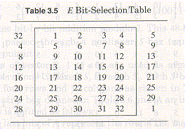
32
Expansion Permutation
48
1
4
5
8
9
12
13
16
17
20
21
24
25
28
29
32
1
48
Notes:
The expansion permutation In table form.

Slide 24
48
48
48
1
48
X-OR with 48 bit key
1
48
Notes:
Simple XOR operation with the subkey for that round.

Slide 25
48
S-Box Substitution
32
1
48
S-box
1
S-box
2
S-box
3
S-box
4
S-box
5
S-box
6
S-box
7
S-box
8
1
4
5
8
9
12
13
16
17
20
21
24
25
28
29
32
Notes:
The S-boxes are somewhat different from the other permutations. While all the others are set up according to "bit x goes to bit y", the input bits can be viewed differently for the S-boxes.
If the input is {d1,d2,d3,d4,d5,d6} then the two-bit number {d1,d6} (row select) and the four-bit number {d2,d3,d4,d5} (column select) are used as indices to the table.
For the 48-bit word {d1,d2..d48}, the word {d1..d6} is sent to S-box 1, the word {d7,,d12} to S-box 2, etc. The output of S-box 1, {o1..o4}, that of S-box 2, {o5..o8} etc. are concatenated to form the 32 bit output.

Slide 26
How an S-Box works
Column select
0 1 2 3 4 5 6 7 8 9 10 11 12 13 14 15
0
1
2
3
14 4 13 1 2 15 11 8 3 10 6 12 5 9 0 7
S-box
1
0 15 7 4 14 2 13 1 10 6 12 11 9 5 3 8
Row select
4 1 14 8 13 6 2 11 15 12 9 7 3 10 5 0
15 12 8 2 4 9 1 7 5 11 3 14 10 0 6 13
Notes:
EX:
Given a 6-bit input to S₁, the 4-bit output is found by selecting the row using the outer two bits (the first and last bits), and the column using the inner four bits.
For example, an input "011011" has outer bits "01" and inner bits "1101“ (Row 1, Column 13) ; the corresponding output would be "0101“ (5).

Slide 27
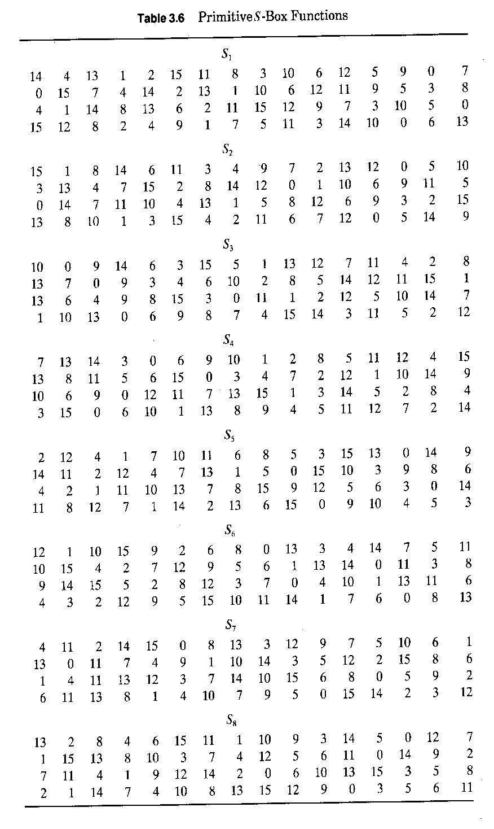
How an S-Box works
Column select
0 1 2 3 4 5 6 7 8 9 10 11 12 13 14 15
0
1
2
3
14 4 13 1 2 15 11 8 3 10 6 12 5 9 0 7
S-box
1
0 15 7 4 14 2 13 1 10 6 12 11 9 5 3 8
Row select
4 1 14 8 13 6 2 11 15 12 9 7 3 10 5 0
15 12 8 2 4 9 1 7 5 11 3 14 10 0 6 13
Notes:
The table shows the contents of all eight S-Boxes.

Slide 28
32
P-Box Permutation
32
1
4
5
8
9
12
13
16
17
20
21
24
25
28
29
32
1
4
5
8
9
12
13
16
17
20
21
24
25
28
29
32
Notes:
This P-box is a straight permutation. The resulting number is XOR-ed with the left half of the input block with which we started at the beginning of this round. Finally, if this is not the last round, we swap the left and right halves and start again.

Slide 29
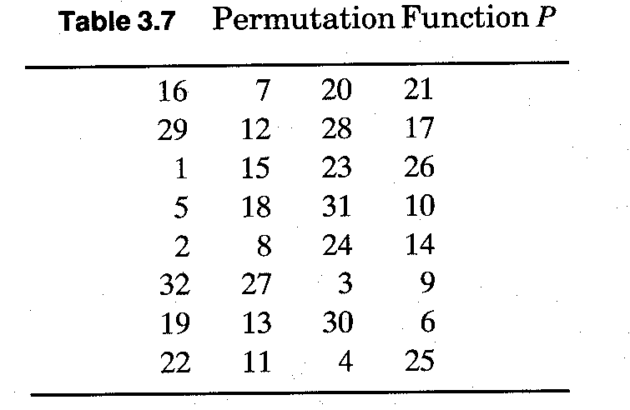
32
P-Box Permutation
32
1
4
5
8
9
12
13
16
17
20
21
24
25
28
29
32
1
4
5
8
9
12
13
16
17
20
21
24
25
28
29
32
Notes:
This is the P-box in table form – you can see that bit 16 is moved to bit 1, bit 7 to bit 2 etc.

Slide 30
IP⁻¹ (Final Permutation):
56
48
40
32
24
16
8
56
48
40
32
24
16
8
Notes:
The initial and final permutations in DES serve no cryptographic function.
They were originally added in order to make it easier to load the 64-bit blocks into hardware - this algorithm after all predates 16-bit busses - and is now often omitted from implementations.
However the permutations are a part of the standard, and therefore any implementation not using the permutations is not truly DES.

Slide 31
IP⁻¹ (Final Permutation):
56
48
40
32
24
16
8
56
48
40
32
24
16
8
Notes:
Final Permutations (inverse of Initial Permutation) in table form. i.e. bit 1 returns to bit 58, etc..

Slide 32
Generate Sub Keys
Initial Key Permutation
8
16
24
32
40
48
56
64
Yellow box is parity bit – every 8th bit
8
16
24
32
40
48
56
Notes:
The key is usually stored as a 64-bit number, where every eighth bit is a parity bit.
The parity bits are removed during the algorithm, and the 56-bit key is used to create 16 different 48-bit subkeys - one for each round.
In order to generate 16 48-bit subkeys from the 56-bit key, the following process is used.
First, the key is loaded according to the Permutation PC-1 above and then halved.

Slide 33
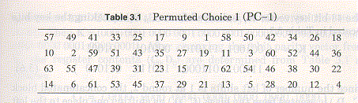
Generate Sub Keys
Initial Key Permutation
8
16
24
32
40
48
56
64
Yellow box is parity bit – every 8th bit
8
16
24
32
40
48
56
Notes:
Permutation PC-1 above in table form.

Slide 34
Generate Sub Keys
Key Split & Shift & Compress
8
16
24
32
40
48
56
K₅₆
Shift left by N_{i}
Shift left by N_{i}
Shift accumulates every round
N_{i} = {1,1,2,2,2,2,2,2,1,2,2,2,2,2,2,1}
8
16
24
32
40
48
56
K₄₈
8
16
24
32
40
48
Notes:
Then each half is rotated by 2 bits in every round except the first, second, 9th and last rounds where only 1 bit is rotated.
The reason for this is that it makes it secure against related-key cryptanalysis.
Then 48 of the 56 bits are chosen according to a compression permutation PC-2.

Slide 35
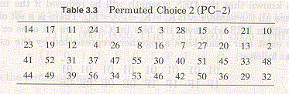
Generate Sub Keys
Key Split & Shift & Compress
8
16
24
32
40
48
56
K₅₆
Shift left by N_{i}
Shift left by N_{i}
Shift accumulates every round
N_{i} = {1,1,2,2,2,2,2,2,1,2,2,2,2,2,2,1}
8
16
24
32
40
48
56
K₄₈
8
16
24
32
40
48
Notes:
Permutation PC-2 in table form.

Slide 36
DES Advantages:
Very Fast:
Ideally suited for implementation in hardware (bit shifts, look-ups etc).
plaintext block
Dedicated hardware (in 1996) could run DES at 200 Mbyte/s.
f
56 bit Key
Well suited for voice, video etc.
ciphertext block
Notes:
DES was designed for hardware as it uses all logical operations.

Slide 37
DES Security:
Not too good:
Trying all 2⁵⁶ possible keys is not that hard these days.
plaintext block
f
56 bit Key
If you spend ~$25k you can build a DES password cracker that will succeed in a few hours.
ciphertext block
Back in 1975 this would have cost a few billion $$. It is widely believed that the NSA did this.
Similar algorithms with longer keys are available today (AES,IDEA).
Notes:
In cryptography, the EFF DES cracker (nicknamed "Deep Crack") is a machine built by the Electronic Frontier Foundation (EFF) in 1998 to perform a brute force search of DES cipher's key space — that is, to decrypt an encrypted message by trying every possible key. The aim in doing this was to prove that DES's key is not long enough to be secure.

Slide 38
DES Example:
Let M be the plain text message M = 0123456789ABCDEF where M is in hexadecimal (base 16) format.
Rewriting M in binary format, we get the 64-bit block of text:
M = 0000 0001 0010 0011 0100 0101 0110 0111 1000 1001 1010 1011 1100 1101 1110 1111
Left and Right Hand sides are:
L = 0000 0001 0010 0011 0100 0101 0110 0111 R = 1000 1001 1010 1011 1100 1101 1110 1111
K is the hexadecimal key K = 133457799BBCDFF1 – in binary this is:-
K = 00010011 00110100 01010111 01111001 10011011 10111100 11011111 11110001
Notes:
The next 15 slides show a simple example of DES in operation. The slides are self explanatory and I will answer any questions on them when you have a chance to look them over.

Slide 39
DES Example:
Step 1: Create 16 subkeys, each of which is 48-bits long
K = 00010011 00110100 01010111 01111001 10011011 10111100 11011111 11110001
we get the 56-bit permutation from PC-1
K+ = 1111000 0110011 0010101 0101111 0101010 1011001 1001111 0001111
Next, split this key into left and right halves, C₀ and D₀, where each half has 28 bits.
Example: From the permuted key K+, we get
C₀ = 1111000 0110011 0010101 0101111 D₀ = 0101010 1011001 1001111 0001111

Slide 40
DES Example:
Step 1: Create 16 subkeys, each of which is 48-bits long
From original pair pair C₀ and D₀ we obtain:
C₀ = 1111000011001100101010101111 D₀ = 0101010101100110011110001111
C₁ = 1110000110011001010101011111 D₁ = 1010101011001100111100011110
C₂ = 1100001100110010101010111111 D₂ = 0101010110011001111000111101
C₃ = 0000110011001010101011111111 D₃ = 0101011001100111100011110101
C₄ = 0011001100101010101111111100 D₄ = 0101100110011110001111010101
C₅ = 1100110010101010111111110000 D₅ = 0110011001111000111101010101
C₆ = 0011001010101011111111000011 D₆ = 1001100111100011110101010101
C₇ = 1100101010101111111100001100 D₇ = 0110011110001111010101010110
C₈ = 0010101010111111110000110011 D₈ = 1001111000111101010101011001
C₉ = 0101010101111111100001100110 D₉ = 0011110001111010101010110011
C₁₀ = 0101010111111110000110011001 D₁₀ = 1111000111101010101011001100
C₁₁ = 0101011111111000011001100101 D₁₁ = 1100011110101010101100110011
C₁₂ = 0101111111100001100110010101 D₁₂ = 0001111010101010110011001111
C₁₃ = 0111111110000110011001010101 D₁₃ = 0111101010101011001100111100
C₁₄ = 1111111000011001100101010101 D₁₄ = 1110101010101100110011110001
C₁₅ = 1111100001100110010101010111 D₁₅ = 1010101010110011001111000111
C₁₆ = 1111000011001100101010101111 D₁₆ = 0101010101100110011110001111

Slide 41
DES Example:
Step 1: Create 16 subkeys, each of which is 48-bits long
We now form the keys K_{n}, for 1<=n<=16, by applying the following permutation table to each of the concatenated pairs C_{n}D_{n}. Each pair has 56 bits, but PC-2 only uses 48 of these.
Therefore, the first bit of K_{n} is the 14th bit of C_{n}D_{n}, the second bit the 17th, and so on, ending with the 48th bit of K_{n} being the 32th bit of C_{n}D_{n}.

Slide 42
DES Example:
Step 1: Create 16 subkeys, each of which is 48-bits long
For the first key we have:
C₁D₁ = 1110000 1100110 0101010 1011111 1010101 0110011 0011110 0011110
which, after we apply the permutation PC-2, becomes
K₁ = 000110 110000 001011 101111 111111 000111 000001 110010

Slide 43
DES Example:
Step 1: Create 16 subkeys, each of which is 48-bits long
K₁ = 000110 110000 001011 101111 111111 000111 000001 110010
For the other keys we have
K₂ = 011110 011010 111011 011001 110110 111100 100111 100101 K₃ = 010101 011111 110010 001010 010000 101100 111110 011001 K₄ = 011100 101010 110111 010110 110110 110011 010100 011101 K₅ = 011111 001110 110000 000111 111010 110101 001110 101000 K₆ = 011000 111010 010100 111110 010100 000111 101100 101111 K₇ = 111011 001000 010010 110111 111101 100001 100010 111100 K₈ = 111101 111000 101000 111010 110000 010011 101111 111011 K₉ = 111000 001101 101111 101011 111011 011110 011110 000001 K₁₀ = 101100 011111 001101 000111 101110 100100 011001 001111 K₁₁ = 001000 010101 111111 010011 110111 101101 001110 000110 K₁₂ = 011101 010111 000111 110101 100101 000110 011111 101001 K₁₃ = 100101 111100 010111 010001 111110 101011 101001 000001 K₁₄ = 010111 110100 001110 110111 111100 101110 011100 111010 K₁₅ = 101111 111001 000110 001101 001111 010011 111100 001010 K₁₆ = 110010 110011 110110 001011 000011 100001 011111 110101

Slide 44
DES Example:
Step 2: Encode each 64-bit block of data
Applying the initial permutation (IP) to the block of text M, given previously, we get:
M = 0000 0001 0010 0011 0100 0101 0110 0111 1000 1001 1010 1011 1100 1101 1110 1111
IP = 1100 1100 0000 0000 1100 1100 1111 1111 1111 0000 1010 1010 1111 0000 1010 1010

Slide 45
DES Example:
Step 2: Encode each 64-bit block of data
Next divide the permuted block IP into a left half L₀ of 32 bits, and a right half R₀ of 32 bits.
Example: From IP, we get L₀ and R₀
L₀ = 1100 1100 0000 0000 1100 1100 1111 1111
R₀ = 1111 0000 1010 1010 1111 0000 1010 1010
We now proceed through 16 iterations, for 1<=n<=16, using a function f which operates on two blocks--a data block of 32 bits and a key K_{n} of 48 bits--to produce a block of 32 bits.
Let + denote XOR addition, (bit-by-bit addition modulo 2). Then for n going from 1 to 16 we calculate
L_{n} = R_{n-1} R_{n} = L_{n-1} + f(R_{n-1},K_{n})

Slide 46
DES Example:
Step 2: Encode each 64-bit block of data
L_{n} = R_{n-1} R_{n} = L_{n-1} + f(R_{n-1},K_{n})
For n = 1, we have
K₁ = 000110 110000 001011 101111 111111 000111 000001 110010 L₁ = R₀ = 1111 0000 1010 1010 1111 0000 1010 1010 R₁ = L₀ + f(R₀,K₁)
It remains to explain how the function f works. To calculate f, we first expand each block R_{n-1} from 32 bits to 48 bits. This is done by using a selection table that repeats some of the bits in R_{n-1} . We'll call the use of this selection table the function E. Thus E(R_{n-1}) has a 32 bit input block, and a 48 bit output block.

Slide 47
DES Example:
Step 2: Encode each 64-bit block of data
Thus E(R_{n-1}) has a 32 bit input block, and a 48 bit output block.
We calculate E(R₀) from R₀ as follows:
R₀ = 1111 0000 1010 1010 1111 0000 1010 1010 E(R₀) = 011110 100001 010101 010101 011110 100001 010101 010101

Slide 48
DES Example:
Step 2: Encode each 64-bit block of data
R₀ = 1111 0000 1010 1010 1111 0000 1010 1010 E(R₀) = 011110 100001 010101 010101 011110 100001 010101 010101
Next in the f calculation, we XOR the output E(R_{n-1}) with the key K_{n}:
K_{n} + E(R_{n-1}).
Example: For K₁ , E(R₀), we have
K₁ = 000110 110000 001011 101111 111111 000111 000001 110010 E(R₀) = 011110 100001 010101 010101 011110 100001 010101 010101
K₁+E(R₀) = 011000 010001 011110 111010 100001 100110 010100 100111

Slide 49
DES Example:
Step 2: Encode each 64-bit block of data
K₁+E(R₀) = 011000 010001 011110 111010 100001 100110 010100 100111
Write the previous result, which is 48 bits, in the form:
K_{n} + E(R_{n-1}) =B₁B₂B₃B₄B₅B₆B₇B₈, where each B_{i} is a group of six bits.
We now calculate
S₁(B₁)S₂(B₂)S₃(B₃)S₄(B₄)S₅(B₅)S₆(B₆)S₇(B₇)S₈(B₈)
where S_{i}(B_{i}) referres to the output of the i-th S box.

Slide 50
DES Example:
Step 2: Encode each 64-bit block of data
For the first round, we obtain as the output of the eight S boxes:
K₁+E(R₀) = 011000 010001 011110 111010 100001 100110 010100 100111.
S₁(B₁)S₂(B₂)S₃(B₃)S₄(B₄)S₅(B₅)S₆(B₆)S₇(B₇)S₈(B₈)
=
0101 1100 1000 0010 1011 0101 1001 0111
The final stage in the calculation of f is to do a permutation P of the S-box output to obtain the final value of f:
f = P(S₁(B₁)S₂(B₂)...S₈(B₈))

Slide 51
DES Example:
Step 2: Encode each 64-bit block of data
From the output of the eight S boxes:
S₁(B₁)S₂(B₂)S₃(B₃)S₄(B₄)S₅(B₅)S₆(B₆)S₇(B₇)S₈(B₈)
=
0101 1100 1000 0010 1011 0101 1001 0111
we get
f = 0010 0011 0100 1010 1010 1001 1011 1011
R₁ = L₀ + f(R₀ , K₁ ) =
1100 1100 0000 0000 1100 1100 1111 1111
+
0010 0011 0100 1010 1010 1001 1011 1011 =
1110 1111 0100 1010 0110 0101 0100 0100

Slide 52
DES Example:
Step 2: Encode each 64-bit block of data
In the next round, we will have L₂ = R₁, which is the block we just calculated, and then we must calculate R₂ =L₁ + f(R₁, K₂), and so on for 16 rounds.
At the end of the sixteenth round we have the blocks L₁₆ and R₁₆. We then reverse the order of the two blocks into the 64-bit block R₁₆L₁₆ and apply a final permutation IP⁻¹ as defined by the following table:

Slide 53
DES Example:
Finally we get
If we process all 16 blocks using the method defined previously, we get, on the 16th round,
L₁₆ = 0100 0011 0100 0010 0011 0010 0011 0100 R₁₆ = 0000 1010 0100 1100 1101 1001 1001 0101
We reverse the order of these two blocks and apply the final permutation to
R₁₆L₁₆ = 00001010 01001100 11011001 10010101 01000011 01000010 00110010 00110100
IP⁻¹ = 10000101 11101000 00010011 01010100 00001111 00001010 10110100 00000101
which in hexadecimal format is 85E813540F0AB405.
This is the encrypted form of M = 0123456789ABCDEF:
namely, C = 85E813540F0AB405.
Notes:
Decryption is simply the inverse of encryption, following the same steps as above, but reversing the order in which the subkeys are applied.

Slide 54
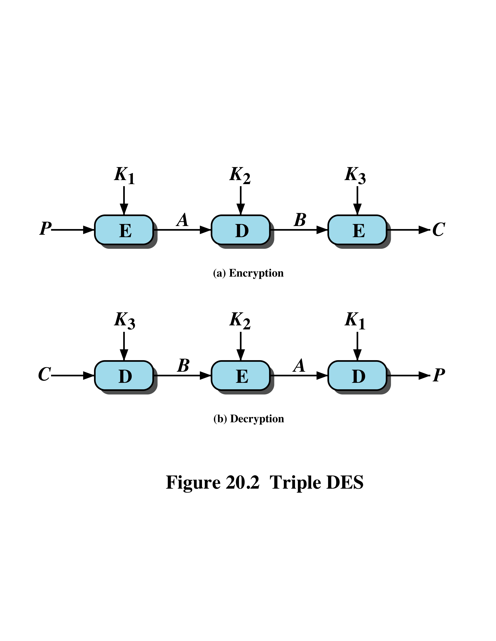
Triple DES (3DES)
First used in financial applications
In DES FIPS PUB 46-3 standard of 1999
Uses three keys and three DES executions:
C = E(K₃, D(K₂, E(K₁, P)))
Decryption same with keys reversed
Use of decryption in second stage gives compatibility with original DES users
Effective 168-bit key length, slow, secure
AES will eventually replace 3DES
C = {{{P}K₁}K₂}K₃
P = {{{C}K3}K2}K1
Notes:
Triple DES (3DES) was first standardized for use in financial applications in ANSI standard X9.17 in 1985. 3DES was incorporated as part of the Data Encryption Standard in 1999, with the publication of FIPS PUB 46-3.
3DES uses three keys and three executions of the DES algorithm. The function follows an encrypt-decrypt-encrypt (EDE) sequence (see Figure 20.2a):
C = E(K₃, D(K₂, E(K₁, P))) C = {{{P}K₁}K₂}K₃
where: C = ciphertext; P = plaintext; E[K, X] or {X}K = encryption of X using key K, and D[K, Y] or {Y}K = decryption of Y using key K.
Decryption is simply the same operation with the keys reversed (Figure 20.2b):
P = D(K₁, E(K₂, D(K₃, C))) P = {{{C}K₃}K₂}K₁
There is no cryptographic significance to the use of decryption for the second stage of 3DES encryption. Its only advantage is that it allows users of 3DES to decrypt data encrypted by users of the older single DES:
C = E(K₁, D(K₁, E(K₁, P))) = E[K, P]
With three distinct keys, 3DES has an effective key length of 168 bits. FIPS 46-3 also allows for the use of two keys, with K₁ = K₃; this provides for a key length of 112 bits. 3DES is a formidable algorithm. Because the underlying cryptographic algorithm is DEA, 3DES can claim the same resistance to cryptanalysis based on the algorithm as is claimed for DEA. Further, with a 168-bit key length, brute-force attacks are effectively impossible. Ultimately, AES is intended to replace 3DES, but this process will take a number of years.

Slide 55
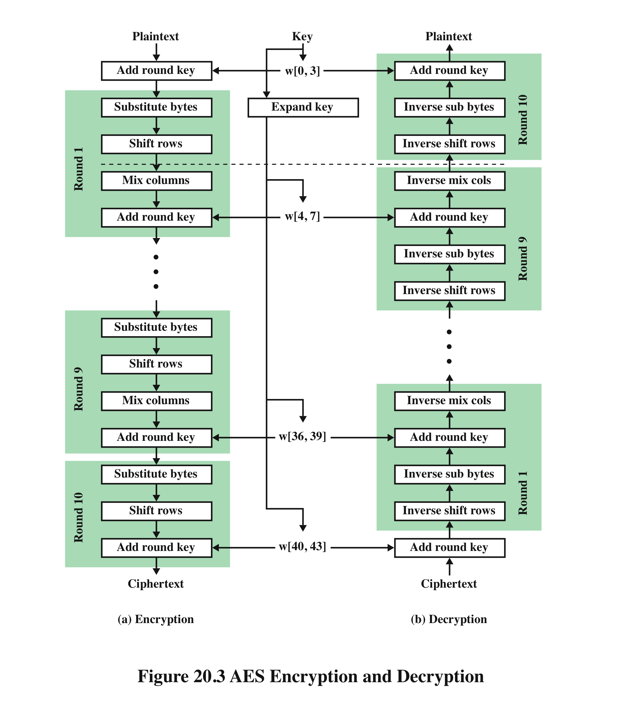
Advanced Encryption Standard (AES)
Notes:
The Advanced Encryption Standard (AES) was issued as a federal information processing standard (FIPS 197). It is intended to replace DES and triple DES with an algorithm that is more secure and efficient. AES uses a block length of 128 bits and a key length that can be 128, 192, or 256 bits. In the description of this section, we assume a key length of 128 bits, which is likely to be the one most commonly implemented.
Figure 20.3 shows the overall structure of AES. The input to the encryption and decryption algorithms is a single 128-bit block.

Slide 56
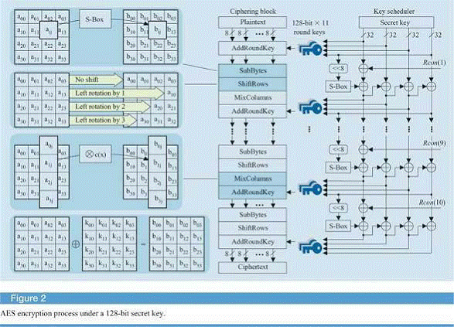
Advanced Encryption Standard (AES)
Click Here for a good demo of AES.
https://www.youtube.com/watch?v=mlzxpkdXP58
Notes:
In FIPS PUB 197, this block is depicted as a square matrix of bytes. This block is copied into the State array, which is modified at each stage of encryption or decryption. After the final stage, State is copied to an output matrix.
Similarly, the 128-bit key is depicted as a square matrix of bytes. This key is then expanded into an array of key schedule words; each word is 4 bytes and the total key schedule is 44 words for the 128-bit key. The ordering of bytes within a matrix is by column. So, for example, the first 4 bytes of a 128-bit plaintext input to the encryption cipher occupy the first column of the in matrix, the second 4 bytes occupy the second column, and so on. Similarly, the first 4 bytes of the expanded key, which form a word, occupy the first column of the w matrix.
The following comments give some insight into AES:
1. One noteworthy feature of this structure is that it is not a Feistel structure.
Recall that in the classic Feistel structure, half of the data block is used to modify the other half of the data block, and then the halves are swapped. AES does not use a Feistel structure but processes the entire data block in parallel during each round using substitutions and permutation.
2. The key that is provided as input is expanded into an array of forty-four 32-bit words, w [ i ]. Four distinct words (128 bits) serve as a round key for each round.
3. Four different stages are used, one of permutation and three of substitution:
• Substitute Bytes: Uses a table, referred to as an S-box, to perform a byte-by-byte substitution of the block
• Shift Rows: A simple permutation that is performed row by row
• Mix Columns: A substitution that alters each byte in a column as a function of all of the bytes in the column
• Add Round key: A simple bitwise XOR of the current block with a portion of the expanded key
See the additional file for a numbered example of the mix columns operation – “MIX Columns Operation of AES.pdf”

Slide 57
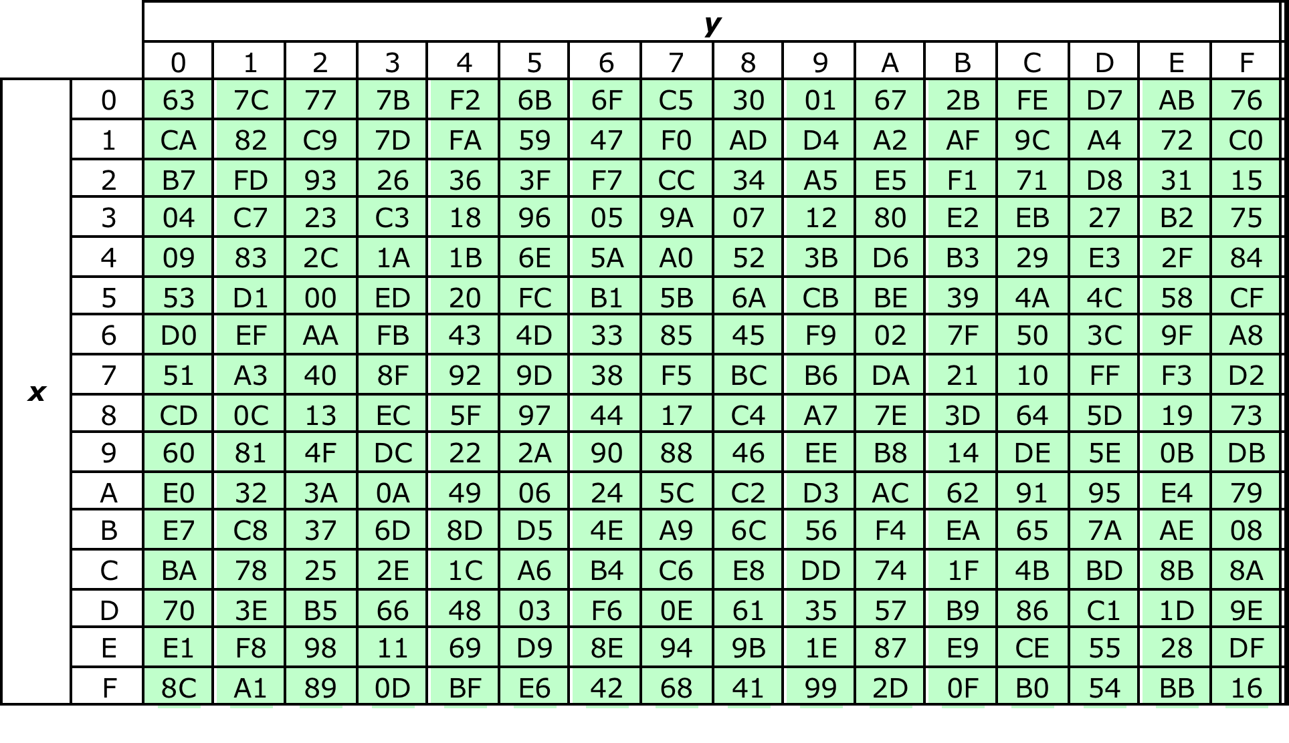
Table 20.2 (a) S-box
Notes:
The substitute byte transformation, called SubBytes, is a simple table lookup. AES defines a 16 x 16 matrix of byte values, called an S-box ( Table 20.2a ), that contains a permutation of all possible 256 8-bit values. Each individual byte of State is mapped into a new byte in the following way: The leftmost 4 bits of the byte are used as a row value and the rightmost 4 bits are used as a column value. These row and column values serve as indexes into the S-box to select a unique 8-bit output value.
For example, the hexadecimal value {95} references row 9, column 5 of the S-box, which contains the value {2A}. Accordingly, the value {95} is mapped into the value {2A}.

Slide 58
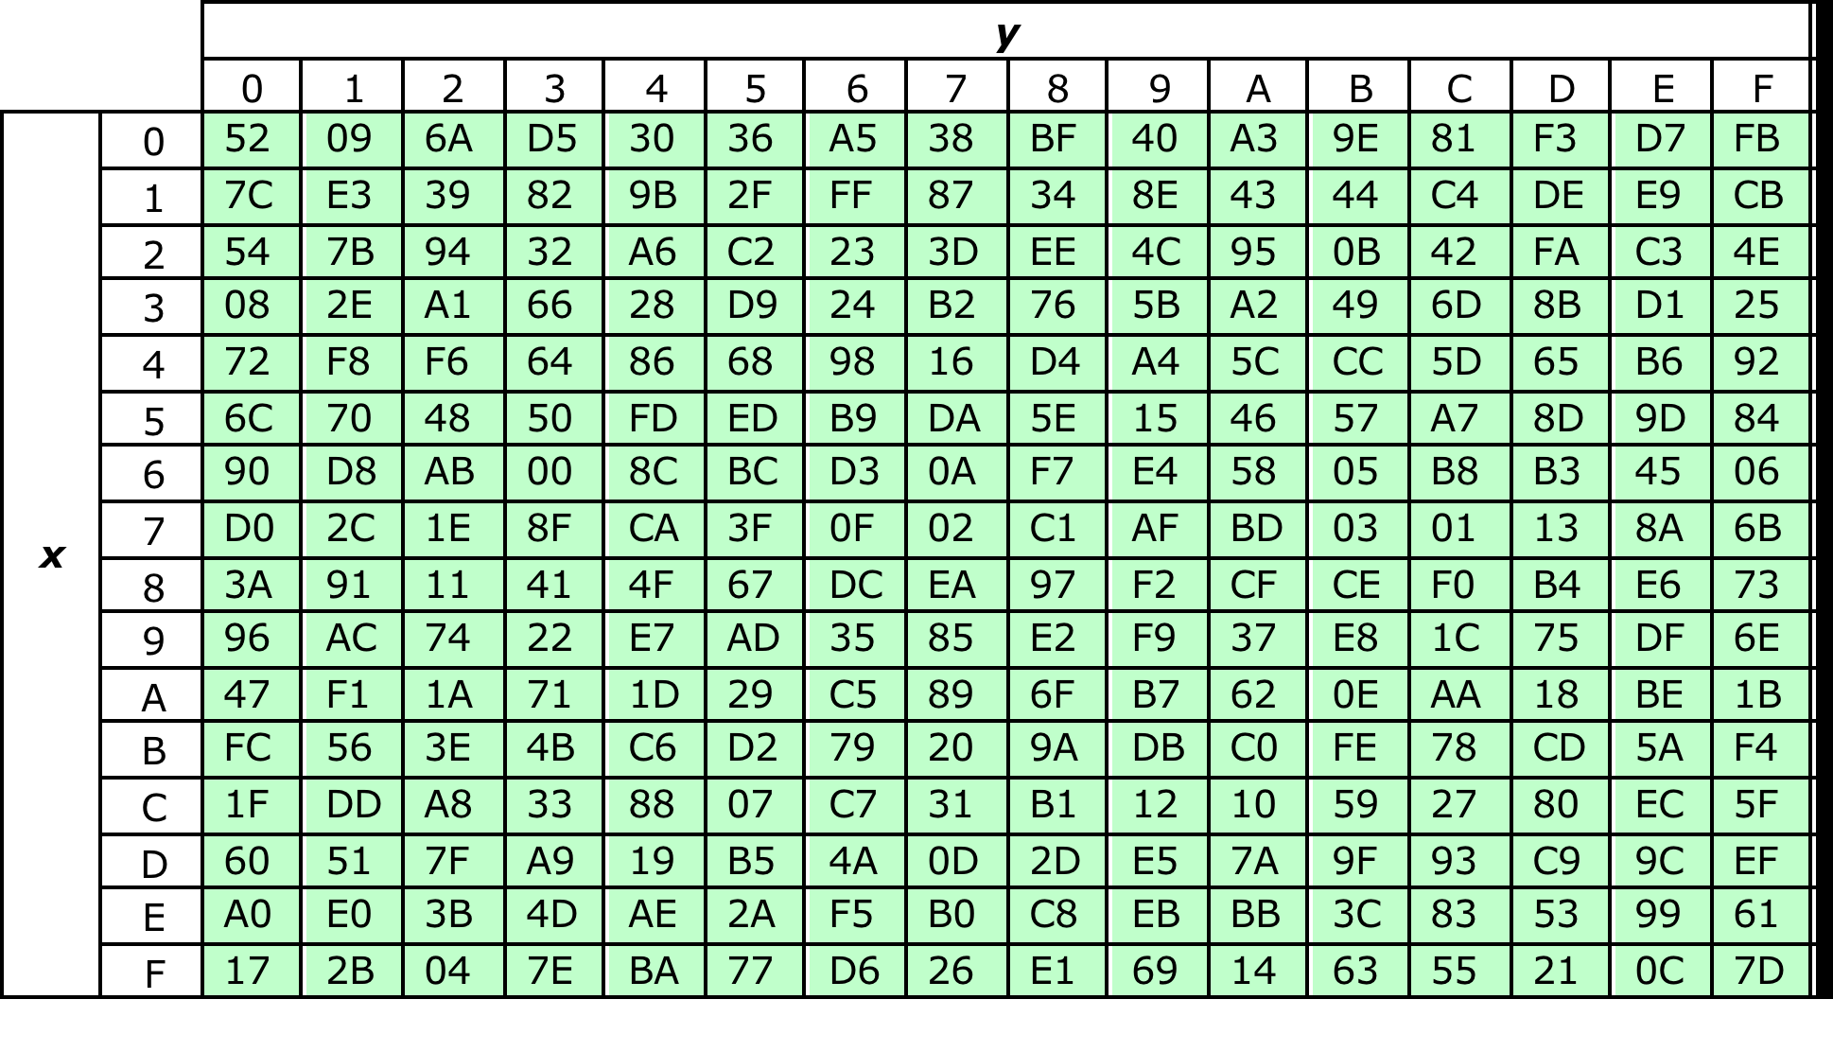
Table 20.2 (b) Inverse S-box
Notes:
The inverse substitute byte transformation, called InvSubBytes, makes use of the inverse S-box shown in Table 20.2b . Note, for example, that the input {2A} produces the output {95}.
The S-box is designed to be resistant to known cryptanalytic attacks. Specifically, the AES developers sought a design that has a low correlation between input bits and output bits and the property that the output cannot be described as a simple mathematical function of the input.

Slide 59
Shift Rows
On encryption left rotate each row of State by 0,1,2,3 bytes respectively
Decryption does reverse
To move individual bytes from one column to another and spread bytes over columns
Notes:
For the forward shift row transformation, called ShiftRows, the first row of State is not altered. For the second row, a 1-byte circular left shift is performed. For the third row, a 2-byte circular left shift is performed. For the third row, a 3-byte circular left shift is performed.
The inverse shift row transformation, called InvShiftRows, performs the circular shifts in the opposite direction for each of the last three rows, with a one-byte circular right shift for the second row, and so on.
See the example “AES-solution.pdf”

Slide 60
Mix Columns and Add Key
Mix columns
Operates on each column individually
Mapping each byte to a new value that is a function of all four bytes in the column
Use of equations over finite fields
To provide good mixing of bytes in column
Add round key
Simply XOR State with bits of expanded key
Security from complexity of round key expansion and other stages of AES
Notes:
The forward mix column transformation, called MixColumns, operates on each column individually. Each byte of a column is mapped into a new value that is a function of all four bytes in the column. The mapping makes use of equations over finite fields. The mapping is designed to provide a good mixing among the bytes of each column. The mix column transformation combined with the shift row transformation ensures that after a few rounds, all output bits depend on all input bits.
In the forward add round key transformation, called AddRoundKey, the 128 bits of State are bitwise XORed with the 128 bits of the round key.
The inverse add round key transformation is identical to the forward add round key transformation, because the XOR operation is its own inverse.
The AES key expansion algorithm takes as input a 4-word (16-byte) key and produces a linear array of 44 words (156 bytes). This is sufficient to provide a 4-word round key for the initial Add Round Key stage and each of the 10 rounds of the cipher.
Further details on how the AES key is used is beyond the scope of this section.

Slide 61
Stream Ciphers
Processes input elements continuously
Key input to a pseudorandom bit generator
Produces stream of random like numbers
Unpredictable without knowing input key
XOR keystream output with plaintext bytes
Are faster and use far less code
Design considerations:
Encryption sequence should have a large period
Keystream approximates random number properties
Uses a sufficiently long key
Notes:
A block cipher processes the input one block of elements at a time, producing an output block for each input block. A stream cipher processes the input elements continuously, producing output one element at a time, as it goes along. Although block ciphers are far more common, there are certain applications in which a stream cipher is more appropriate. In this section, we look at perhaps the most popular symmetric stream cipher, RC4.
A typical stream cipher encrypts plaintext 1 byte at a time, although a stream cipher may be designed to operate on 1 bit at a time or on units larger than a byte at a time. Figure 2.3b previously seen is a representative diagram of stream cipher structure. In this structure a key is input to a pseudorandom bit generator that produces a stream of 8-bit numbers that are apparently random. A pseudorandom stream is one that is unpredictable without knowledge of the input key and that has an apparently random character. The output of the generator, called a keystream , is combined 1 byte at a time with the plaintext stream using the bitwise exclusive-OR (XOR) operation.

Slide 62
Notes:
With a properly designed pseudorandom number generator, a stream cipher can be as secure as block cipher of comparable key length. The primary advantage of a stream cipher is that stream ciphers are almost always faster and use far less code than do block ciphers. The example in this section, RC4, can be implemented in just a few lines of code. The figure compares execution times of RC4 with other well-known symmetric block ciphers. The advantage of a block cipher is that you can reuse keys. However, if two plaintexts are encrypted with the same key using a stream cipher, then cryptanalysis is often quite simple. If the two ciphertext streams are XORed together, the result is the XOR of the original plaintexts. If the plaintexts are text strings, credit card numbers, or other byte streams with known properties, then cryptanalysis may be successful.
For applications that require encryption/decryption of a stream of data, such as over a data communications channel or a browser/Web link, a stream cipher might be the better alternative. For applications that deal with blocks of data, such as file transfer, e-mail, and database, block ciphers may be more appropriate. However, either type of cipher can be used in virtually any application.

Slide 63
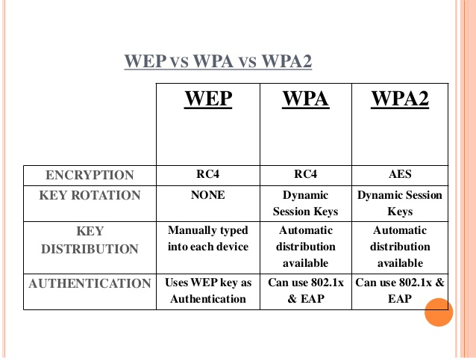
RC4 and WEP
Notes:
RC4 is a stream cipher designed in 1987 by Ron Rivest for RSA Security. It is a variable key-size stream cipher with byte-oriented operations. The algorithm is based on the use of a random permutation. RC4 is used in the SSL/TLS standards that have been defined for communication between Web browsers and servers. It is also used in the WEP protocol and the newer WiFi WPA protocol that are part of the IEEE 802.11 wireless LAN standard. RC4 was originally kept as a trade secret by RSA Security, but in September 1994, the RC4 algorithm was anonymously posted on the Internet.
A number of papers have been published analyzing methods of attacking RC4, but none of these approaches is practical against RC4 with a reasonable key length, such as 128 bits. There are problems with the way it was used in WEP (no key rotation enforced as WEP protocol doesn’t offer any key management provisions). This points out the difficulty in designing a secure system that involves both cryptographic functions and protocols that make use of them.

Slide 64
Symmetric Algorithms
Symmetric Encryption Algorithm | Key length (in bits) | Description
DES | 56 | Designed at IBM during the 1970s and was the NIST standard until 1997. Although considered outdated, DES remains widely in use. Designed to be implemented only in hardware, and is therefore extremely slow in software.
3DES | 112 and 168 | Based on using DES three times which means that the input data is encrypted three times and therefore considered much stronger than DES. However, it is rather slow compared to some new block ciphers such as AES.
AES | 128, 192, and 256 | Fast in both software and hardware, is relatively easy to implement, and requires little memory. As a new encryption standard, it is currently being deployed on a large scale.
Software Encryption Algorithm (SEAL) | 160 | SEAL is an alternative algorithm to DES, 3DES, and AES. It uses a 160-bit encryption key and has a lower impact to the CPU when compared to other software-based algorithms.
The RC series | RC2 (40 and 64) RC4 (1 to 256) RC5 (0 to 2040) RC6 (128, 192, and 256) | A set of symmetric-key encryption algorithms invented by Ron Rivest. RC1 was never published and RC3 was broken before ever being used. RC4 is the world's most widely used stream cipher. RC6, a 128-bit block cipher based heavily on RC5, was an AES finalist developed in 1997.
Notes:
This is a summary of some of the most common Symmetric algorithms. In the table you can see the key length of each algorithm and generally speaking this determines the security of the algorithm.

Slide 65
Selecting an Algorithm
 | DES | 3DES | AES
The algorithm is trusted by the cryptographic community | Been replaced by 3DES | Yes | Verdict is still out
The algorithm adequately protects against brute-force attacks | No | Yes | Yes
Notes:
The three most discussed algorithms in literature are DES, 3DES and AES. Currently AES is replacing 3DES in many applications due to it speed and key size.

Slide 66
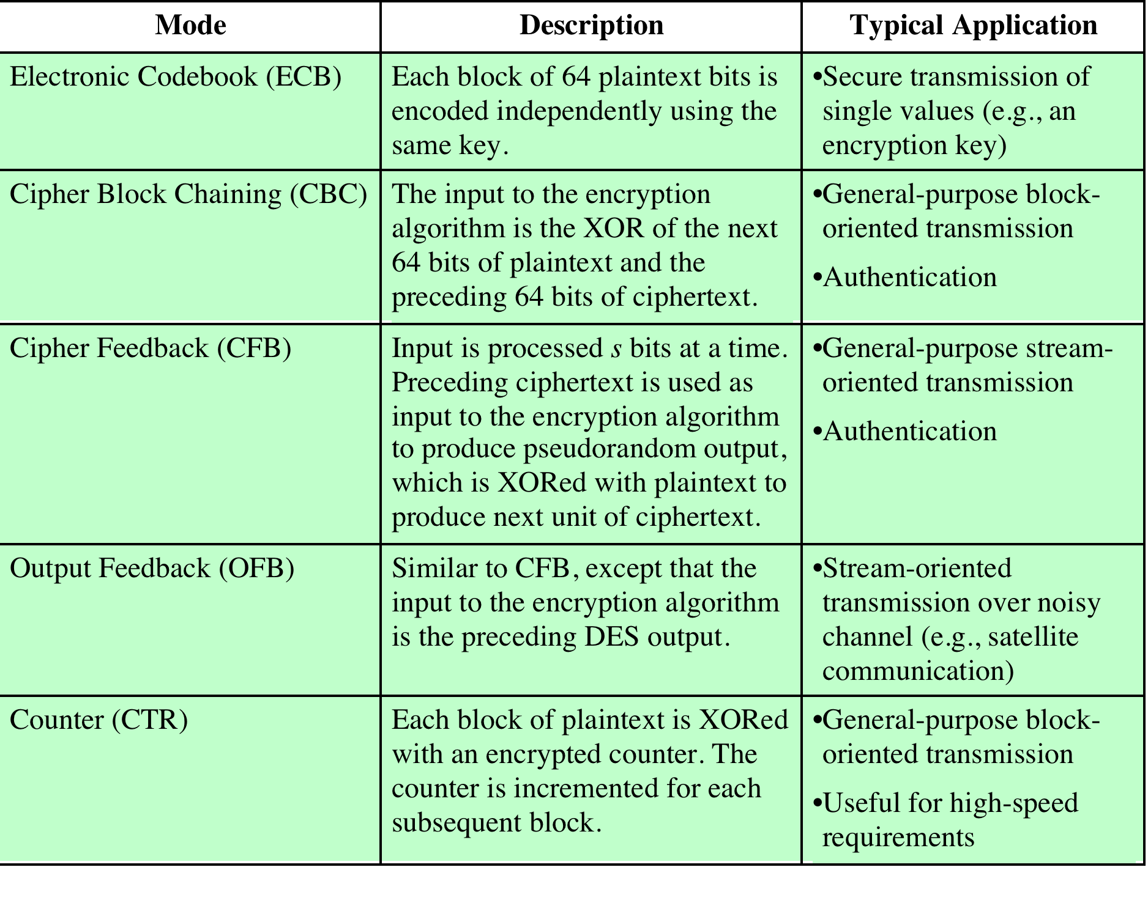
Modes of Operation
Notes:
A symmetric block cipher processes one block of data at a time. In the case of DES and 3DES, the block length is 64 bits. For longer amounts of plaintext, it is necessary to break the plaintext into 64-bit blocks (padding the last block if necessary).
To apply a block cipher in a variety of applications, five modes of operation have been defined by NIST (Special Publication 800-38A). The five modes are intended to cover virtually all the possible applications of encryption for which a block cipher could be used. These modes are intended for use with any symmetric block cipher, including triple DES and AES. The modes are summarized in the Table, and the most important are described briefly in the remainder of this section.

Slide 67
Electronic Codebook (ECB)
ECB
Simplest mode
Plaintext is handled b bits at a time and each block is encrypted using the same key
“codebook” because you have a unique ciphertext value for each plaintext block
Not secure for long messages since repeated plaintext is seen in repeated ciphertext
To overcome security deficiencies you need a technique where the same plaintext block, if repeated, produces different ciphertext blocks
Message of n 64-Bit Blocks
….
DES
DES
DES
DES
DES
….
Notes:
The simplest way to proceed is what is known as electronic codebook (ECB) mode, in which plaintext is handled b bits at a time and each block of plaintext is encrypted using the same key (i.e. C = {P}K_{ab}). The term codebook is used because, for a given key, there is a unique ciphertext for every b-bit block of plaintext.
With ECB, if the same b-bit block of plaintext appears more than once in the message, it always produces the same ciphertext. Because of this, for lengthy messages, the ECB mode may not be secure. If the message is highly structured, it may be possible for a cryptanalyst to exploit these regularities. For example, if it is known that the message always starts out with certain predefined fields (company name for ex), then the cryptanalyst may have a number of known plaintext-ciphertext pairs to work with. If the message has repetitive elements, with a period of repetition a multiple of b bits, then these elements can be identified by the analyst. This may help in the analysis or may provide an opportunity for substituting or rearranging blocks.
To overcome the security deficiencies of ECB, we would like a technique in which the same plaintext block, if repeated, produces different ciphertext blocks.

Slide 68
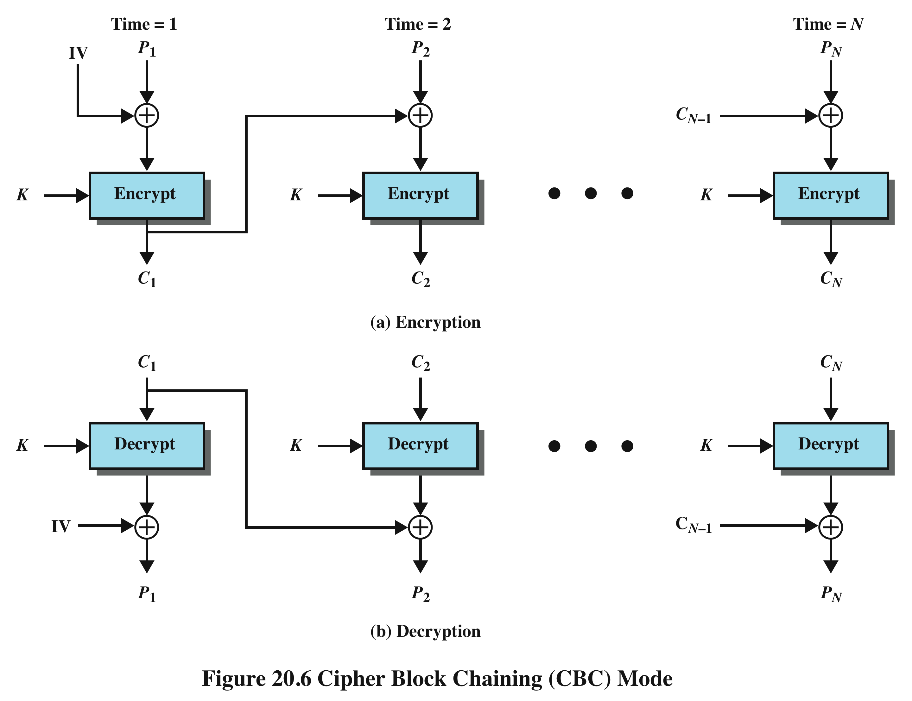
Cipher Block Chaining (CBC)
Notes:
In the cipher block chaining (CBC) mode (Figure 20.6), the input to the encryption algorithm is the XOR of the current plaintext block and the preceding ciphertext block; the same key is used for each block. In effect, we have chained together the processing of the sequence of plaintext blocks. The input to the encryption function for each plaintext block bears no fixed relationship to the plaintext block. Therefore, repeating patterns of b bits are not exposed. CBC is widely used in security applications.
For decryption, each cipher block is passed through the decryption algorithm. The result is XORed with the preceding ciphertext block to produce the plaintext block. To see that this works, we can write:
C_{j} = E(K, [C_{j–1} ⊕ P_{j}]) also in my notation C_{j} = {C_{j–1} ⊕ P_{j}}K
where E[K, X] ( {X}K ) is the encryption of plaintext X using key K, and ⊕ is the exclusive-OR operation.
To produce the first block of ciphertext, an initialization vector (IV) is XORed with the first block of plaintext. On decryption, the IV is XORed with the output of the decryption algorithm to recover the first block of plaintext (inverse property of XOR).
The IV must be known to both the sender and receiver. For maximum security, the IV should be protected as well as the key. This could be done by sending the IV using ECB encryption. One reason for protecting the IV is as follows: If an opponent is able to fool the receiver into using a different value for IV, then the opponent is able to invert selected bits in the first block of plaintext.

Slide 69
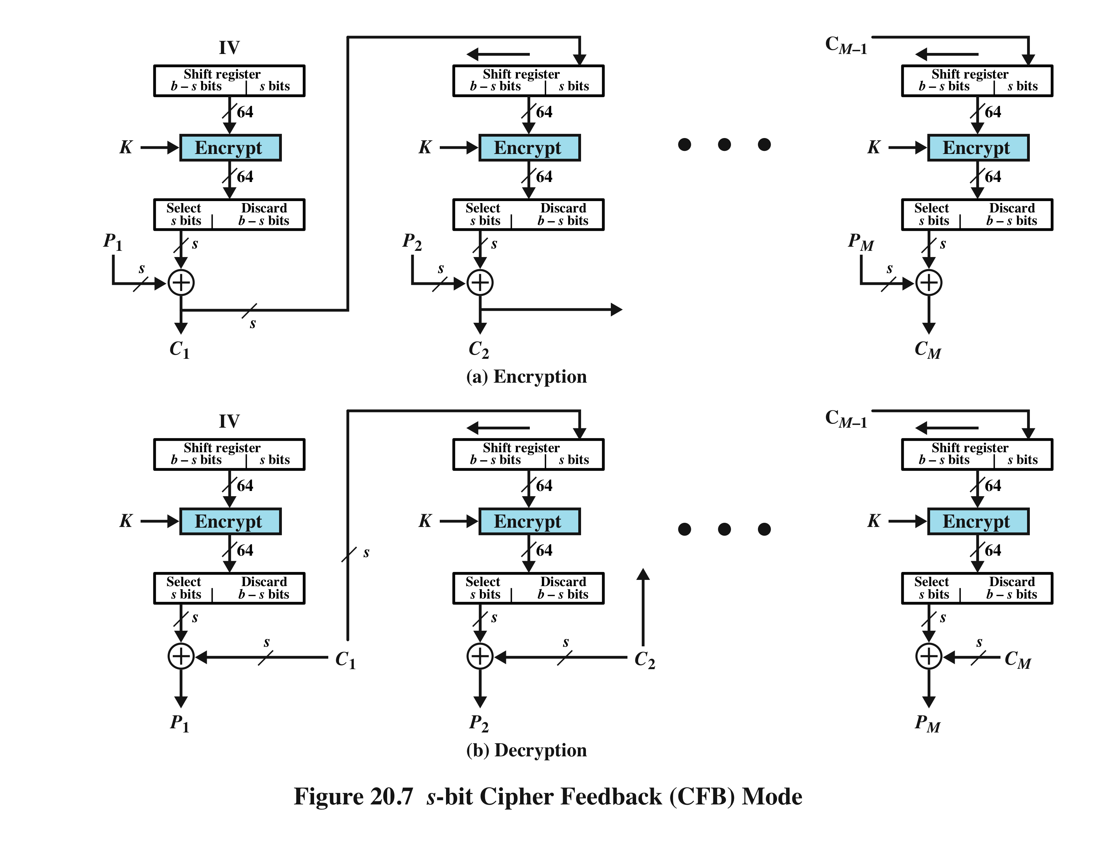
Cipher Feedback (CFB)
Notes:
It is possible to convert any block cipher into a stream cipher by using the cipher feedback (CFB) mode. A stream cipher eliminates the need to pad a message to be an integral number of blocks. It also can operate in real time. Thus, if a character stream is being transmitted, each character can be encrypted and transmitted immediately using a character-oriented stream cipher. One desirable property of a stream cipher is that the ciphertext be of the same length as the plaintext – no redundancy added.
Figure 20.7 depicts the CFB scheme. In the figure, it is assumed that the unit of transmission is s bits; a common value is s = 8 (byte). As with CBC, the units of plaintext are chained together.
For encryption, the input to the encryption function is a b-bit shift register that is initially set to some initialization vector (IV). The leftmost (most significant) s bits (generally 8 bits) of the output of the encryption function are XORed with the first unit of plaintext P₁ to produce the first unit of ciphertext C₁, which is then transmitted. In addition, the contents of the shift register are shifted left by s bits and C₁ is placed in the rightmost (least significant) s bits of the shift register. This process continues until all plaintext units have been encrypted.
Will have:
C₁ = P₁ ⊕ S_{s}[E(K, IV)] or C₁ = P₁ ⊕ S_{s}[ {IV}K ]
For decryption, the same scheme is used, except that the received ciphertext unit is XORed with the output of the encryption function to produce the plaintext unit. Note that it is the encryption function that is used, not the decryption function. This works because of the inverse property of XOR.
Then have
P₁ = C₁ ⊕ S_{s}[E(K, IV)] or P₁ = C₁ ⊕ S_{s}[ {IV}K ]
The same reasoning holds for subsequent steps in the process.

Slide 70
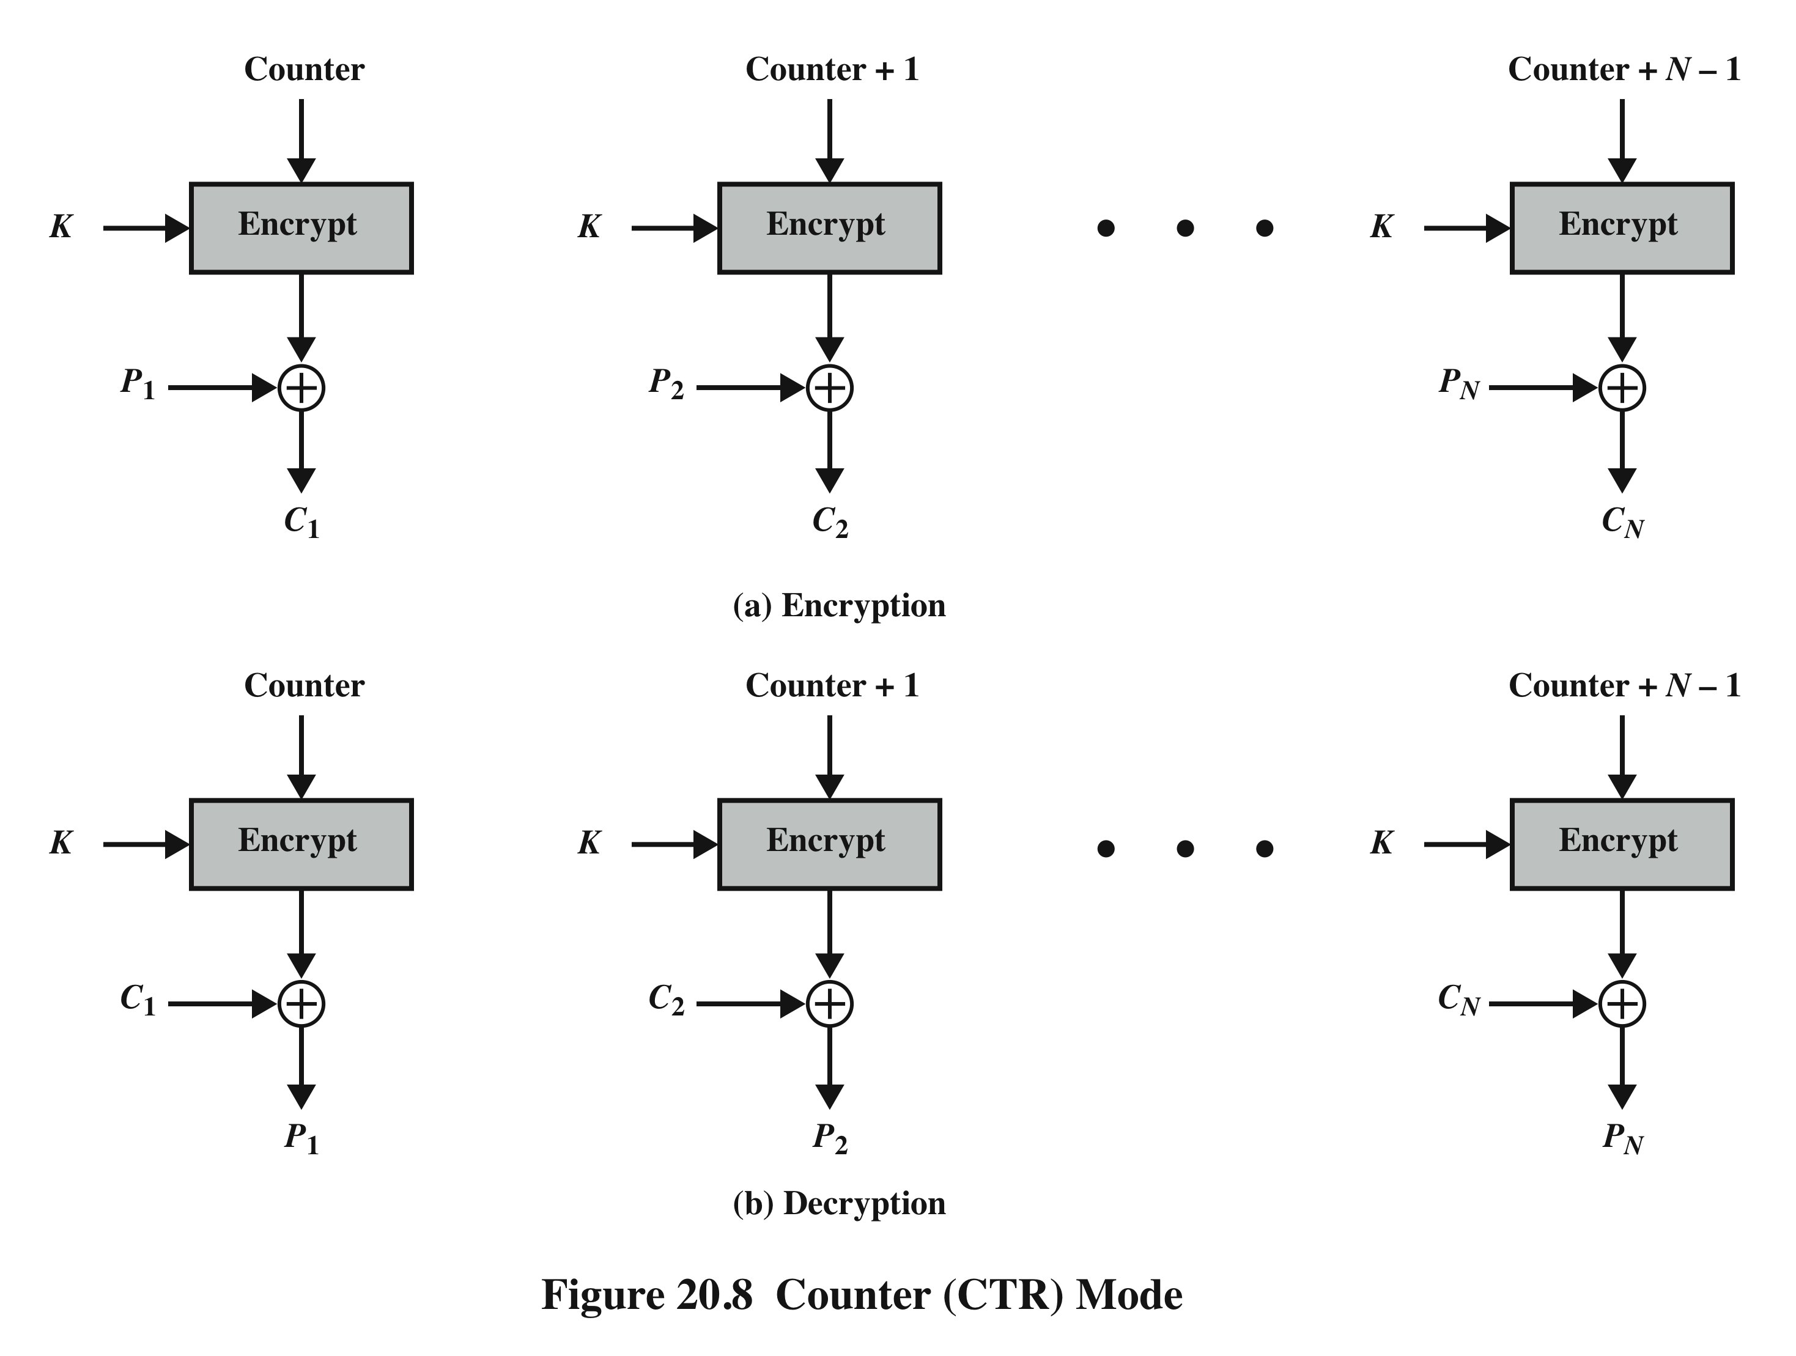
Counter (CTR)
Notes:
Although interest in the counter mode (CTR) has increased recently, with applications to ATM (asynchronous transfer mode) network security and IPSec (IP Security), this mode was proposed early on.
Figure 20.8 depicts the CTR mode. A counter, equal to the plaintext block size is used. The only requirement stated in SP 800-38A is that the counter value must be different for each plaintext block that is encrypted. Typically, the counter is initialized to some value and then incremented by 1 for each subsequent block (modulo 2^{b}, where b is the block size). For encryption, the counter is encrypted and then XORed with the plaintext block to produce the ciphertext block; there is no chaining. For decryption, the same sequence of counter values is used, with each encrypted counter XORed with a ciphertext block to recover the corresponding plaintext block.
Some advantages of CTR mode are :
• Hardware efficiency: CTR mode can be done in parallel on multiple blocks of plaintext or ciphertext. Therefore CTR mode, the throughput is only limited by the amount of parallelism that is achieved.
• Software efficiency: has opportunities for parallel execution in CTR mode.
• Preprocessing: can be used to prepare the output of the encryption boxes that feed into the XOR functions in Figure 20.8.
• Random access: The ith block of plaintext or ciphertext can be processed in random-access fashion. With chaining modes this is not possible as block C_{i} cannot be computed until the (i-1) prior block are computed
• Provable security: CTR is at least as secure as the other modes as long as the counter value and key remain secret.
• Simplicity: CTR mode only needs the implementation of the encryption algorithm and not the decryption algorithm. This matters most when the decryption algorithm differs substantially from the encryption algorithm, as it does for AES. In addition, the decryption key scheduling need not be implemented.

Slide 71
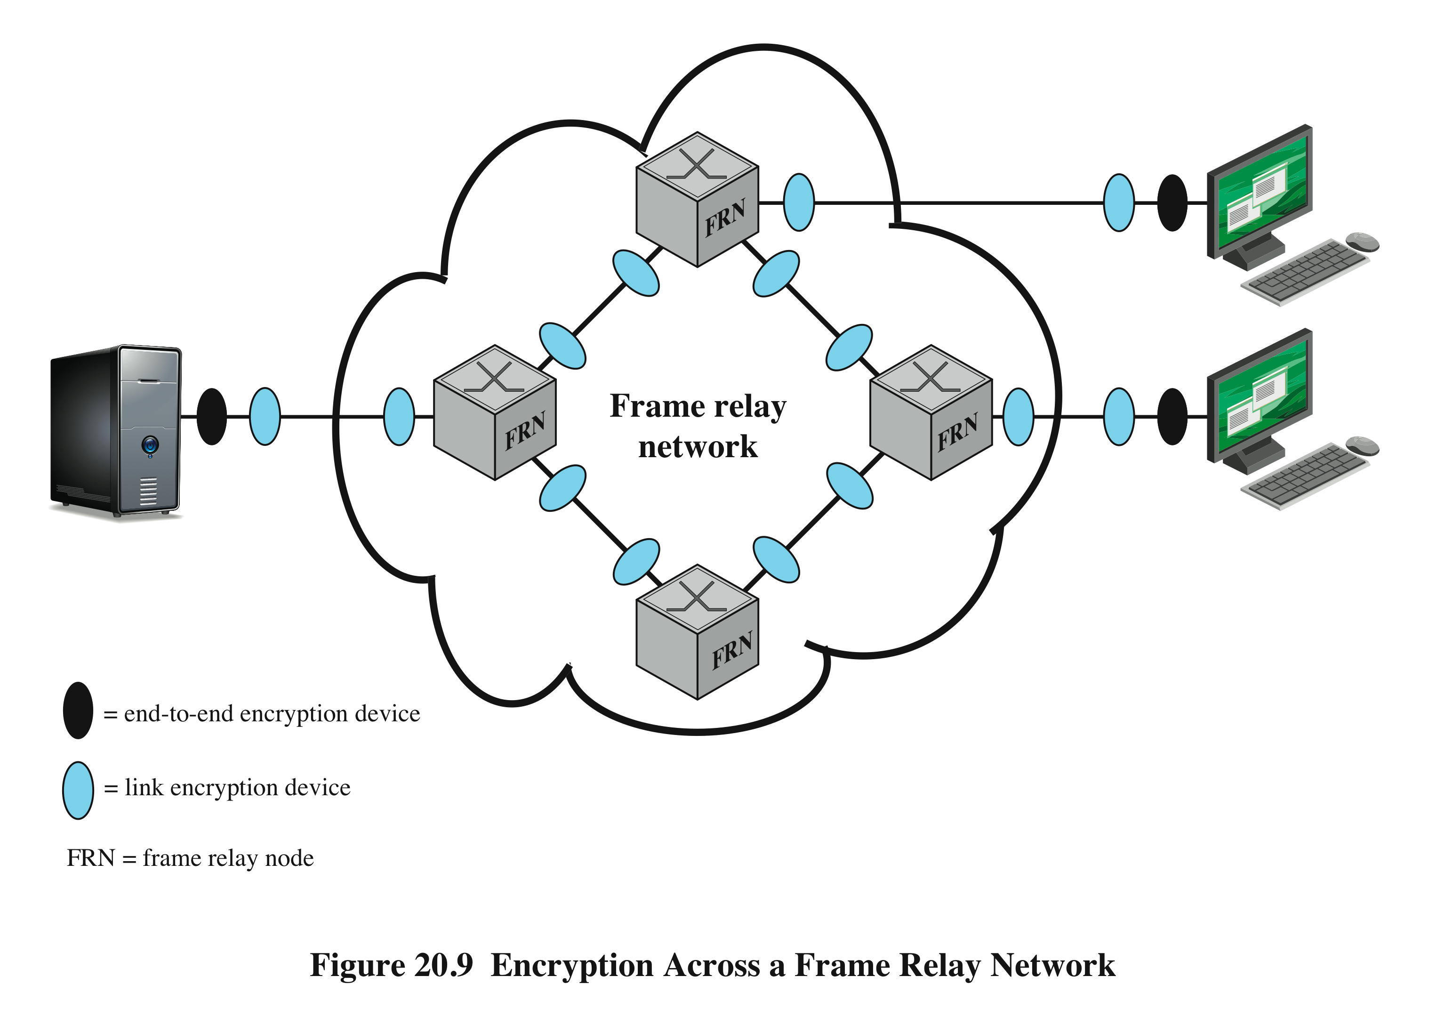
Location of Encryption
Notes:
The most powerful, and most common, approach to countering the threats to network security is encryption. In using encryption, we need to decide what to encrypt and where the encryption should be located. There are two fundamental alternatives: link encryption and end-to-end encryption; these are illustrated in use over a frame network in the Figure.
With link encryption, each vulnerable communications link is equipped on both ends with an encryption device. Thus, all traffic over all communications links is secured. Although this requires a lot of encryption devices in a large network, it provides a high level of security. One disadvantage of this approach is that the message must be decrypted each time it enters a frame switch; this is necessary because the switch must read the address (connection identifier) in the frame header to route the frame. Thus, the message is vulnerable at each switch. If this is a public frame-relay network, the user has no control over the security of the nodes.
With end-to-end encryption, the encryption process is carried out at the two end systems. The source host or terminal encrypts the data. The data, in encrypted form, are then transmitted unaltered across the network to the destination terminal or host. The destination shares a key with the source and so is able to decrypt the data. This approach would seem to secure the transmission against attacks on the network links or switches. There is, however, still a weak spot. Consider the following situation. A host connects to a frame relay network, sets up a logical data link connection to another host, and is prepared to transfer data to that other host using end-to-end encryption. Data are transmitted over such a network in the form of frames, consisting of a header and some user data. What part of each frame will the host encrypt? Suppose that the host encrypts the entire frame, including the header. This will not work because, remember, only the other host can perform the decryption. The frame relay node will receive an encrypted frame and be unable to read the header. Therefore, it will not be able to route the frame. It follows that the host may only encrypt the user data portion of the frame and must leave the header in the clear, so that it can be read by the network. Thus, with end-to-end encryption, the user data are secure. However, the traffic pattern is not, because frame headers are transmitted in the clear. To achieve greater security, both link and end-to-end encryption are needed, as shown in the Figure. Later in the course IPSec will be discussed.
To summarize, when both forms are employed, the host encrypts the user data portion of a frame using an end-to-end encryption key. The entire frame is then encrypted using a link encryption key. As the frame traverses the network, each switch decrypts the frame using a link encryption key to read the header and then encrypts the entire frame again for sending it out on the next link. Now the entire frame is secure except for the time that the frame is actually in the memory of a frame switch, at which time the frame header is in the clear.

Slide 72
Key Distribution
The means of delivering a key to two parties that wish to exchange data without allowing others to see the key
Two parties (A and B) can achieve this by:
1
A third party could select the key and physically deliver it to A and B
If A and B have previously and recently used a key, one party could transmit the new key to the other, encrypted using the old key
If A and B each have an encrypted connection to a third party C, C could deliver a key on the encrypted links to A and B
2
3
4
A key could be selected by A and physically delivered to B
Notes:
For symmetric encryption to work, the two parties to an exchange must share the same key, and that key must be protected from access by others. Furthermore, frequent key changes are usually desirable to limit the amount of data compromised if an attacker learns the key. Therefore, the strength of any cryptographic system rests with the key distribution technique, a term that refers to the means of delivering a key to two parties that wish to exchange data, without allowing others to see the key. Key distribution can be achieved in a number of ways. For two parties A and B,
1. A key could be selected by A and physically delivered to B.
2. A third party could select the key and physically deliver it to A and B.
3. If A and B have previously and recently used a key, one party could transmit the new key to the other, encrypted using the old key.
4. If A and B each have an encrypted connection to a third party C, C could deliver a key on the encrypted links to A and B.
Options 1 and 2 call for manual delivery of a key. For link encryption, this is a reasonable requirement, because each link encryption device is only going to be exchanging data with its partner on the other end of the link. However, for end-to-end encryption, manual delivery is awkward. In a distributed system, any given host or terminal may need to engage in exchanges with many other hosts and terminals over time. Thus, each device needs a number of keys, supplied dynamically. The problem is especially difficult in a wide area distributed system.
Option 3 is a possibility for either link encryption or end-to-end encryption, but if an attacker ever succeeds in gaining access to one key, then all subsequent keys are revealed. Even if frequent changes are made to the link encryption keys, these should be done manually. To provide keys for end-to-end encryption, option 4 is preferable.

Slide 73
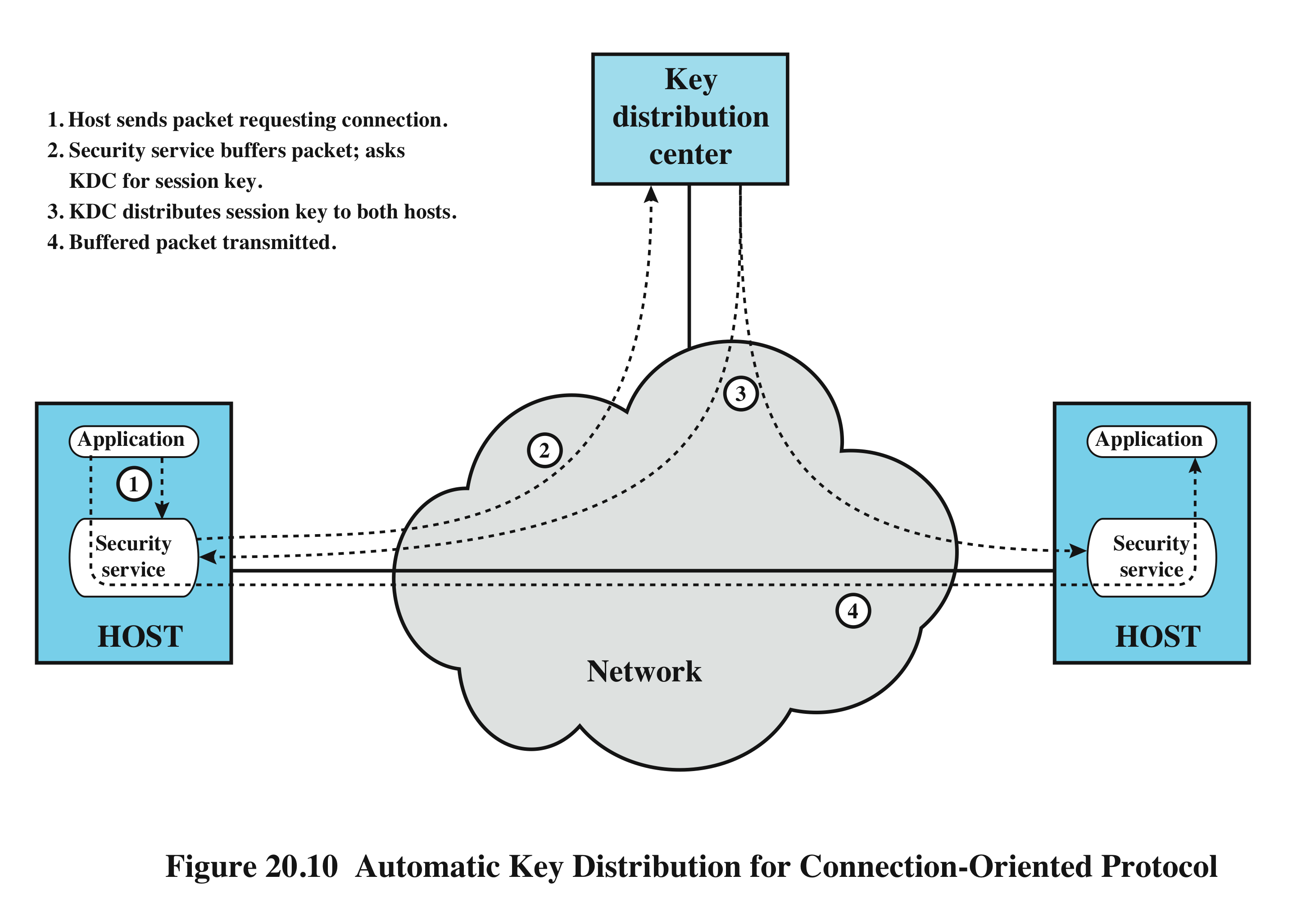
Key Distribution
Notes:
Figure 20.10 illustrates an implementation that satisfies option 4 for end-to-end encryption. In the figure, link encryption is ignored. This can be added, or not, as required. For this scheme, two kinds of keys are identified:
• Session key : When two end systems (hosts, terminals, etc.) wish to communicate, they establish a logical connection (e.g., virtual circuit). For the duration of that logical connection, all user data are encrypted with a one-time session key. At the conclusion of the session, or connection, the session key is destroyed.
• Permanent key: A permanent key is a key used between entities for the purpose of distributing session keys.
The configuration consists of the following elements:
• Key distribution center : The key distribution center (KDC) determines which systems are allowed to communicate with each other. When permission is granted for two systems to establish a connection, the KDC provides a one-time session key for that connection.
• Security service module (SSM): This module, which may consist of functionality at one protocol layer, performs end-to-end encryption and obtains session keys on behalf of users.
The steps involved in establishing a connection are shown in Figure 20.10 . When one host wishes to set up a connection to another host, it transmits a connection request packet (step 1). The SSM saves that packet and applies to the KDC for permission to establish the connection (step 2). The communication between the SSM and the KDC is encrypted using a master key shared only by this SSM and the KDC. If the KDC approves the connection request, it generates the session key and delivers it to the two appropriate SSMs, using a unique permanent key for each SSM (step 3). The requesting SSM can now release the connection request packet, and a connection is set up between the two end systems (step 4). All user data exchanged between the two end systems are encrypted by their respective SSMs using the one-time session key.
The automated key distribution approach provides the flexibility and dynamic characteristics needed to allow a number of terminal users to access a number of hosts and for the hosts to exchange data with each other.
Another approach to key distribution uses public-key encryption, which is discussed in Chapter 21 .

Slide 74
Summary
Symmetric encryption principles
cryptography
cryptanalysis
Feistel cipher structure
Data encryption standard (DES)
Triple DES
Advanced encryption standard (AES)
Algorithm details
Key distribution intro
Stream ciphers
Stream cipher structure
RC4 and WEP
Cipher block modes of operation
Electronic codebook mode
Cipher block chaining mode
Cipher feedback mode
Counter mode
Location of symmetric encryption devices
Notes:
Section topics discussed.

